Slide 1
Pharmacy

Slide 2
Pharmacy
We have two flavors of pharmacy application, one for independent pharmacy and one for pharmacy associated with a hospital.
This application covers end to end flow from receipt of stock from stockiest to selling of drugs, billing with GST, alert with list of drugs which reached below the defined threshold limit, various reports encompassing current stock, sales for a selected period etc.,
Our advanced option supports Multi-location pharmacies, return of purchased drugs with credit voucher option, SMS alerts to registered patients

Slide 3
PHARMACY MODULE
Initial Setup
Stock Invetory
Drug Issue & Bills
Reports
Stock setup
Drug Setup
Generic Setup
Pharmacy Sales
Sales Returns
Stock Invoice
Stock Receipts
Return Stock
Sales Reports
Purchase Report
Stock & Sales Report
Expiry Drugs Report
Reorder Reports

Slide 4
Pharmacy Screen Flow

Slide 5
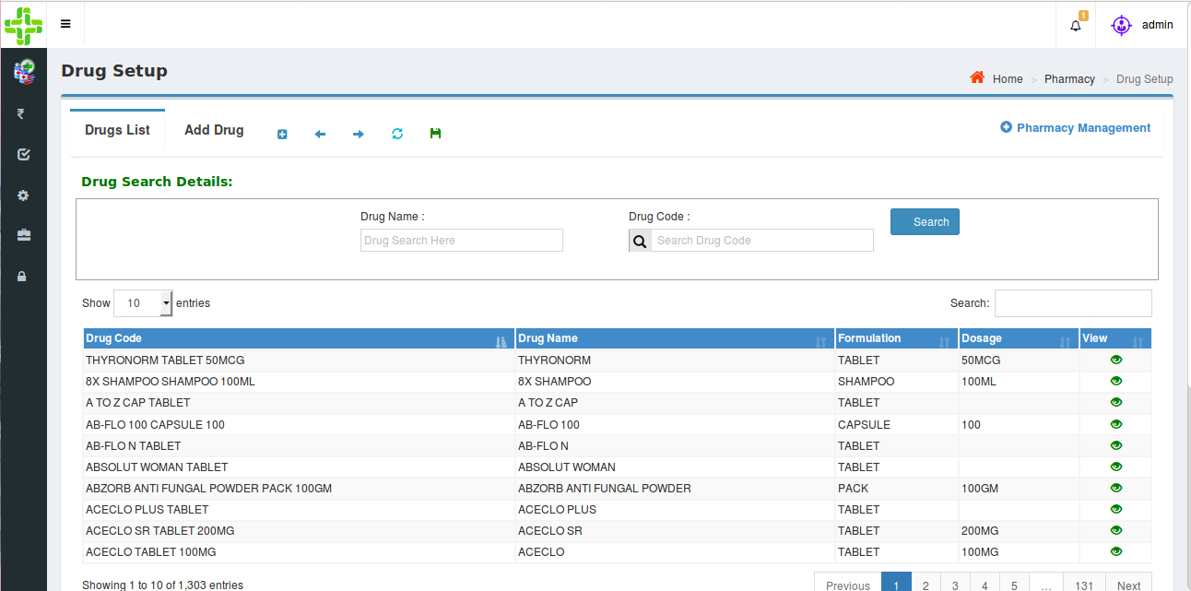
Pharmacy Flow
Drug Setup:
Users can add drug details as well as Generic drugs and setup threshold limit for each drug.
Users can view/edit all the entered drug details.
INPUT PARAMETERS : Drug Name, Formulation, Dosage, HSN Code, MRP, GST %
OUPUT PARAMETERS : Identical to input parameters, which navigates to stock receipts,
sales and report screens.

Slide 6
Pharmacy Flow
Stockist Setup:
- Users can add the details of Stockists.
- Users can view/edit all the entered Stockists.
INPUT PARAMETERS – Stockist Name, GST Number, Contact Details.
OUTPUT PARAMETERS – Stockist Name, which navigates to Stock Invoice.
Generic Setup:
- A drug without brand name is a Generic. Every individual drug has its own generic name.
- Users can add, edit the generics.
INPUT PARAMETERS - Generic Name.
OUTPUT PARAMETERS - Generic Name navigates to Drugs Setup Screen.

Slide 7
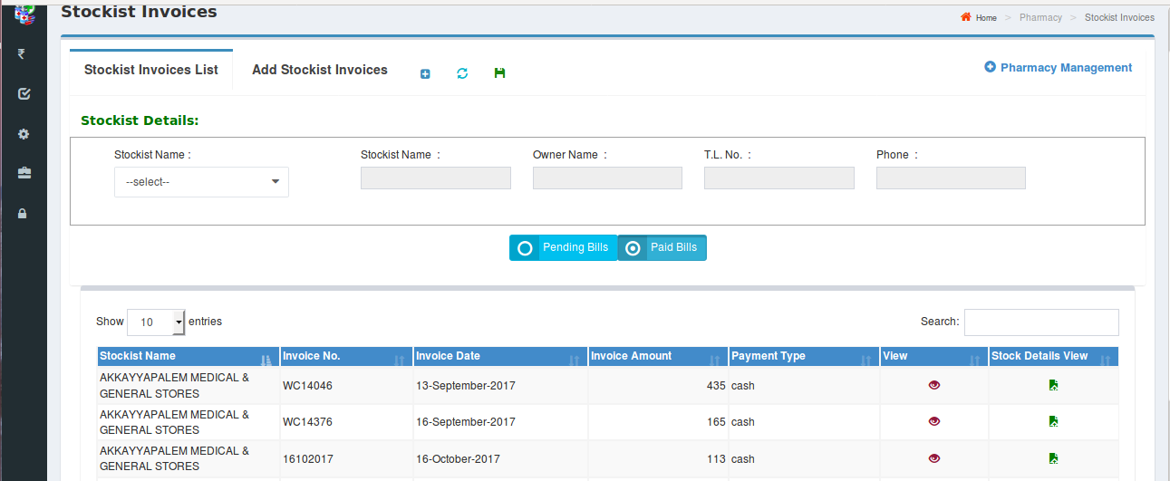
Pharmacy Flow
Stock Invoice:
- Users can add invoices for selected stockist
- Users can view invoices; invoice details and drug details entered under particular invoice
INPUT PARAMETERS – Invoice Number, Invoice Date, Gross Amount, Payment Type, Discount
Percentage, Discount Amount, SGST Amount, CGST Amount, GST Amount, Final Invoice Amount.
OUTPUT PARAMETERS – Identical to input parameters, navigates to Stock Receipts and Return Stock.

Slide 8
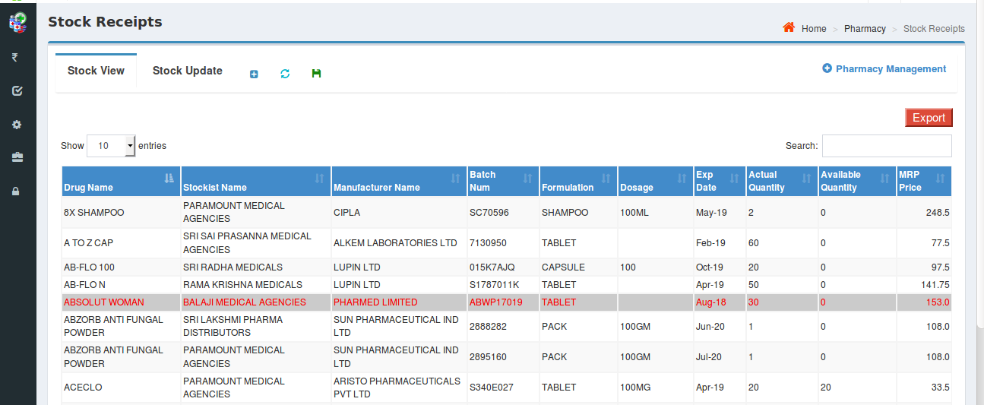
Pharmacy Flow
Stock Receipts:
- Users can enter details of received stock depending on the respective stockist and invoice number.
INPUT PARAMETERS - Batch Number, Expiry Date, Quantity, MRP, Distributor Amount.
OUTPUT PARAMETERS - Identical to input parameters, navigates to Sales, Return Stock and Reports
respectively.
Drugs which are about to expired are indicated with a specific color.

Slide 9
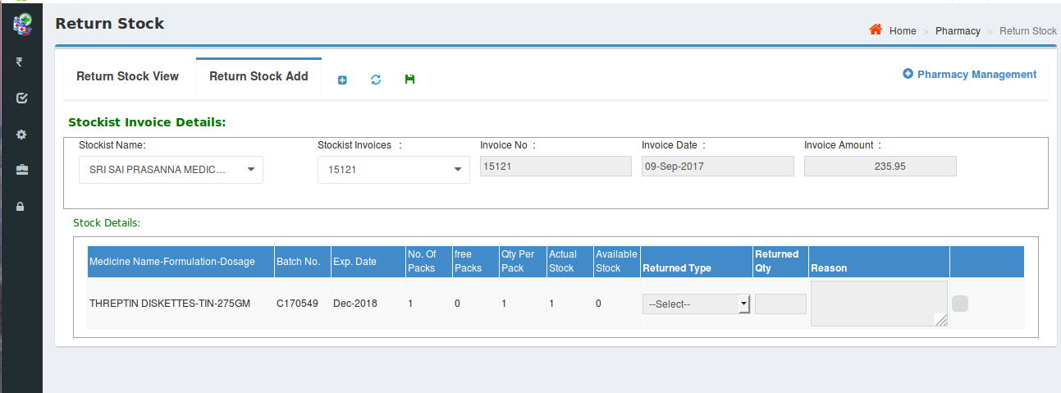
Pharmacy Flow
The retail pharmacy user can return drugs to the stockist either fully or partially under selected invoice.
Returned stock can either be damaged or not moveable drugs.

Slide 10
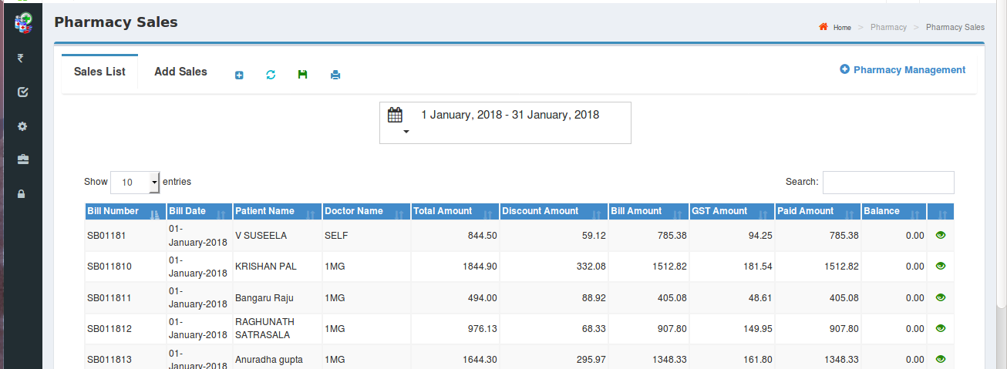
Pharmacy Flow
Pharmacy Sales:
- The retail sale details along with the details of the patient can be captured.
- The details of retail sales for a selected time period can be viewed.

Slide 11
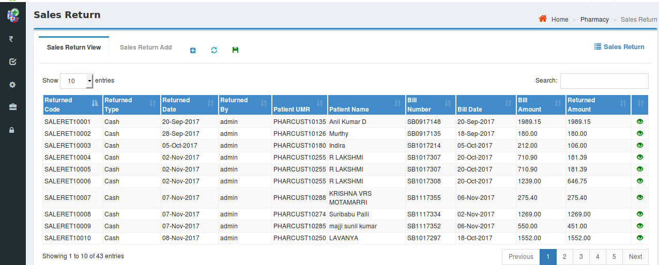
Pharmacy Flow
Sales Return:
- The details of the returned medicines by a patient can be captured
- The list of returned medicines along with other details can be viewed

Slide 12
Pharmacy Flow
Reports:
Our application covers various kinds of reports and some of them are as follows:
Sales Report: Summary and detailed description of sales for a selected referral/Doctor and for a selected time period.
Purchase Report: Summary and detailed description of the purchases for a selected time period.
Stock and Sales Report: Drug wise purchased quantity/value, sales quantity/value, stock and ‘Value of stock on hand’ are populated in this report
Expiry Drugs Report: Details of expired drugs are generated in this report.
Re-order Report: The list of drugs whose quantity is below the threshold limit are displayed so as to be re-ordered
All reports have options to ‘Export to Excel’ and ‘Export to Pdf’

Slide 13
Pharmacy Reports

Slide 14
Pharmacy Reports

