Slide 1
Ophthalmology

Slide 2
Ophthalmology
Atri's ophthalmology application is a web based application which covers registration of patients, patient appointments, billing and maintenance of complete patient medical record with unique number.
Our state of the art application makes it easy to run the end to end operations hassle-free.
The application contains reception module, optometrist module, doctor module, counsellor module, IP module, OT module, optical module, billing modules and reports with dash board .
Web based application: The application is accessible from any computer connected to the Internet using a standard web browser.
Open source components: Atri uses all open source components which eliminates licensing cost for the software's that are being used.
Main features of application:
SMS and email alerts for all major activities like patient appointments, referrals, review follow up etc.
Token management system for scheduling appointments. Unique patient identification.
Centralized patient data access. Patient waiting alerts.
Multiple reports using jasper studio.

Slide 3
Ophthalmology Screen Flow

Slide 4
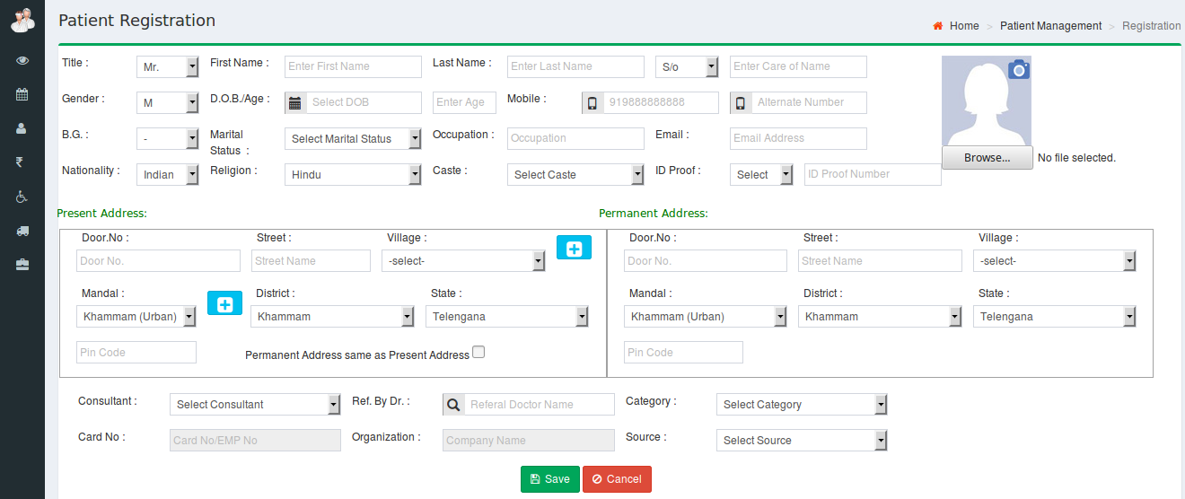
Patient Registration
New patient registration will be handled in the application by taking all the basic information from the patient using the following screen.

Slide 5
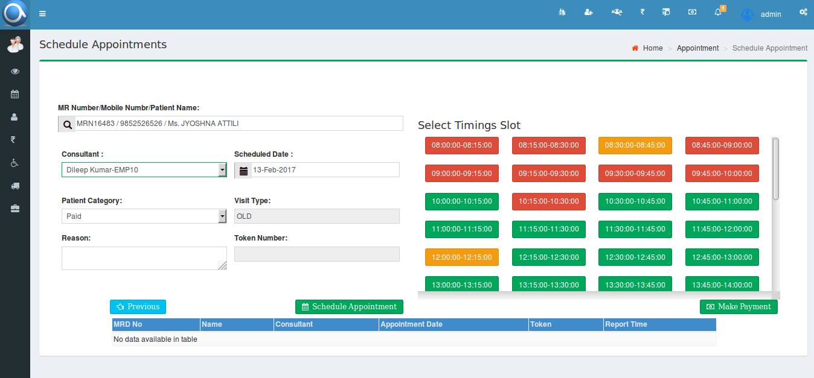
Scheduling Appointment
User can schedule the appoints in the following screen by selecting patient's unique id, relevant doctor and the appointment date and time.

Slide 6
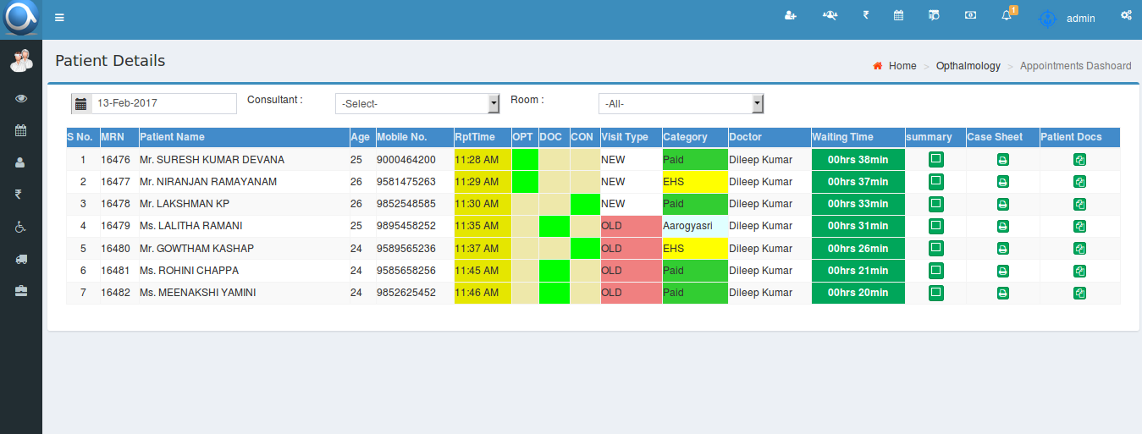
Reception page
The user can control the patient flow by the following screen, Here users can see where the patient is located.

Slide 7
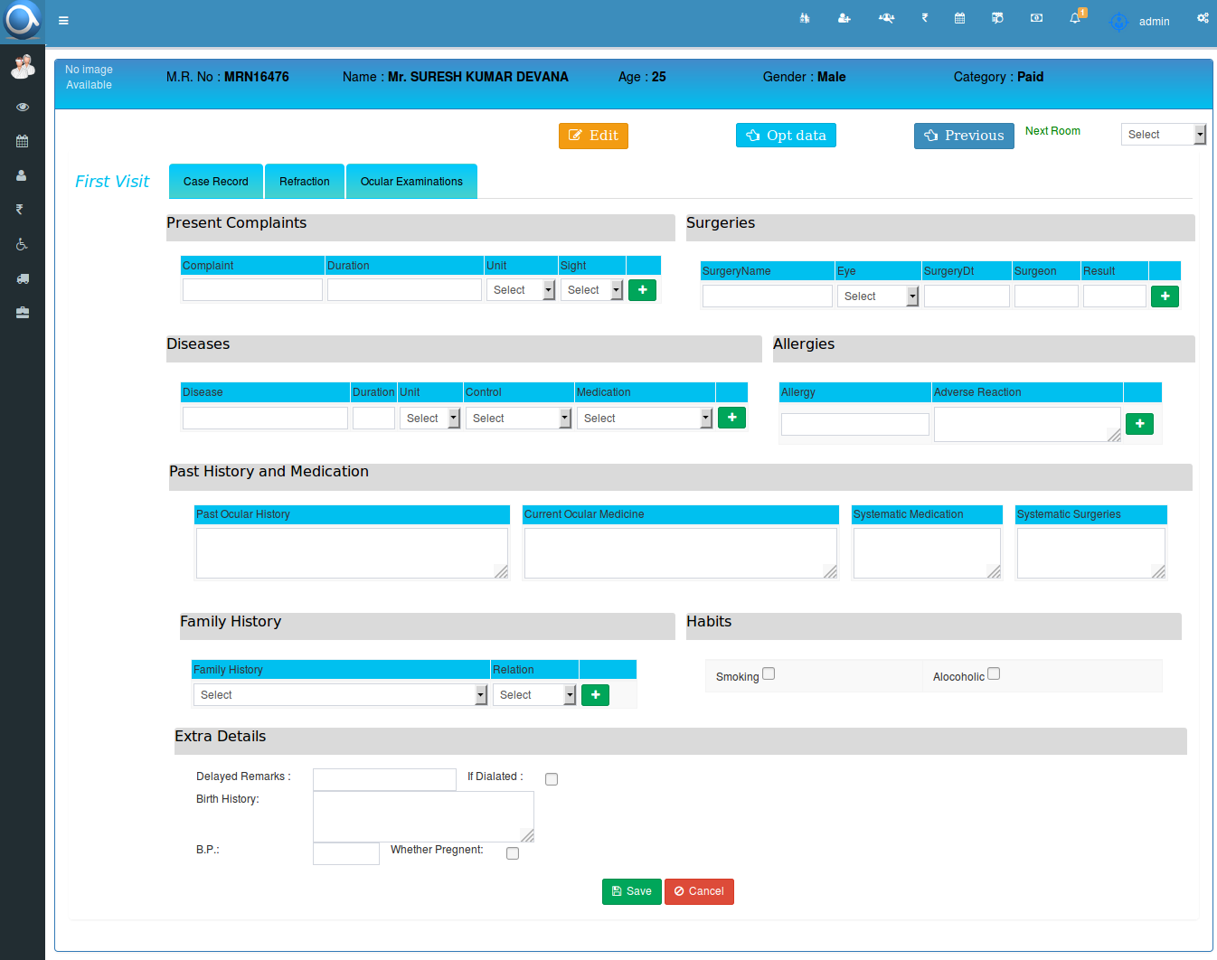
Optometrist Examination
After consultation billing, patient will be sent to the optometrist room. Optometrist handles the patient using the following screens.
Patient complaints, allergies, past history and family history details will be entered using the following screen.

Slide 8
Optometrist Examination
Vision details, auto refraction details, PGP, retinoscopy, subjective refraction and glasses prescription will enter in the following screen.

Slide 9
Optometrist Examination
Slit lamp details, IOP details and syringing details will be entered using the following screen.

Slide 10
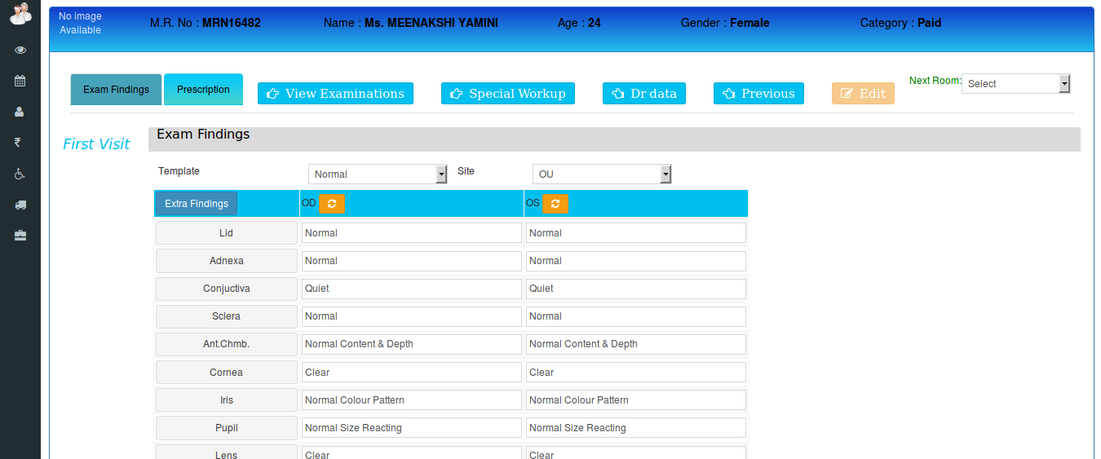
Doctor Examination
Doctor examination will be handled using the following screen.

Slide 11
Doctor Examination
Doctor can prescribe the diagnosis, investigations, procedures, medicines, surgery whichever is applicable to the patient using following screen.

Slide 12
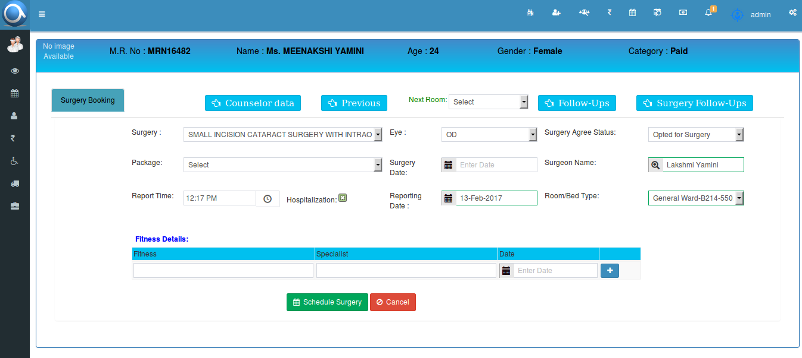
Counsellor
If the patient is opted for surgery then the counsellor explains the surgery packages and schedules the surgery.

Slide 13
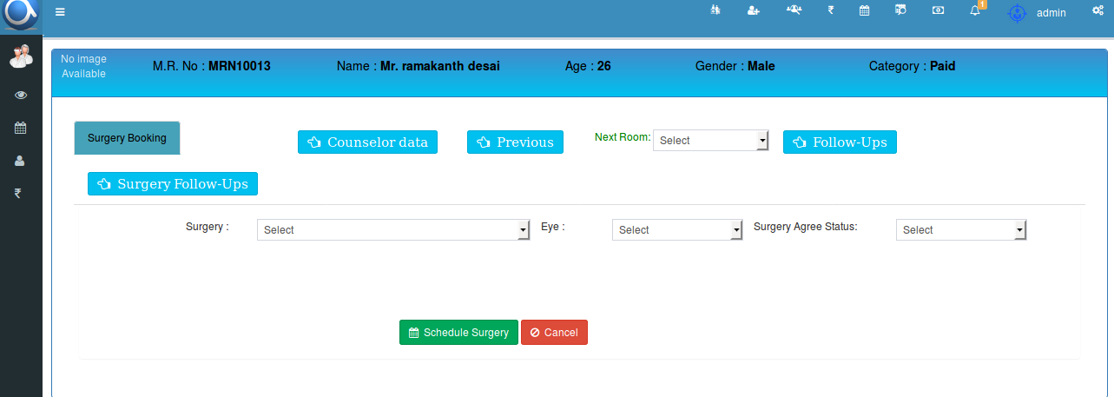
Counsellor
If the patient is not yet decided about the surgery, counsellor will take the remarks and the follow up date for tracking.

Slide 14
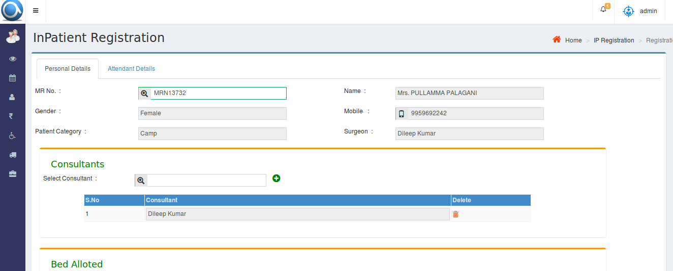
IP Registration
After counsellor schedules the surgery, patient will be appeared for ip registration and this will be handled using the following screen.

Slide 15
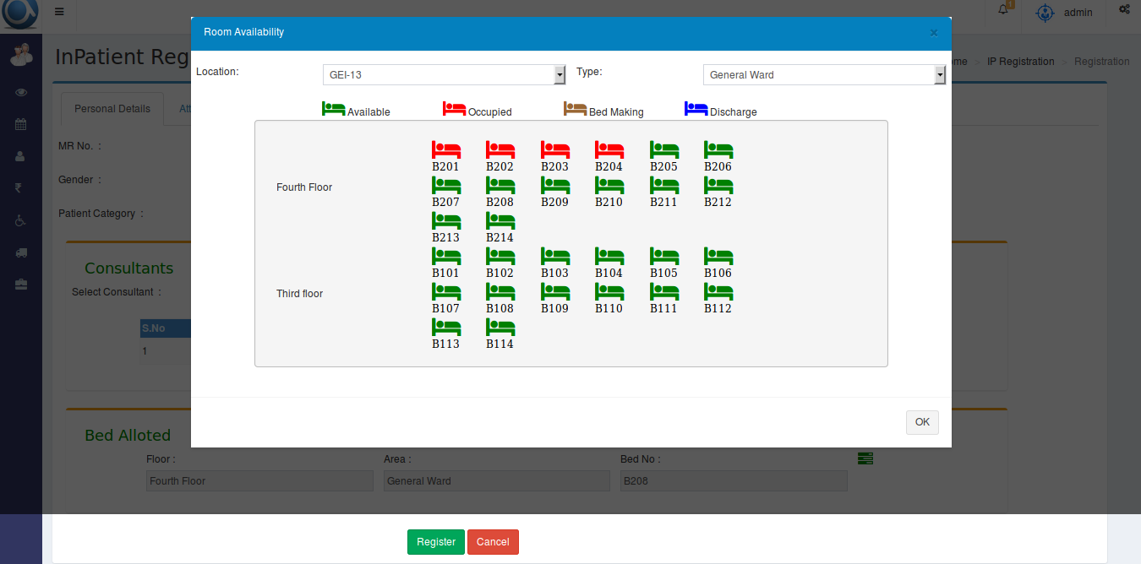
IP Registration
Bed allocation will also be done in the IP registration by selecting the available bed.

Slide 16
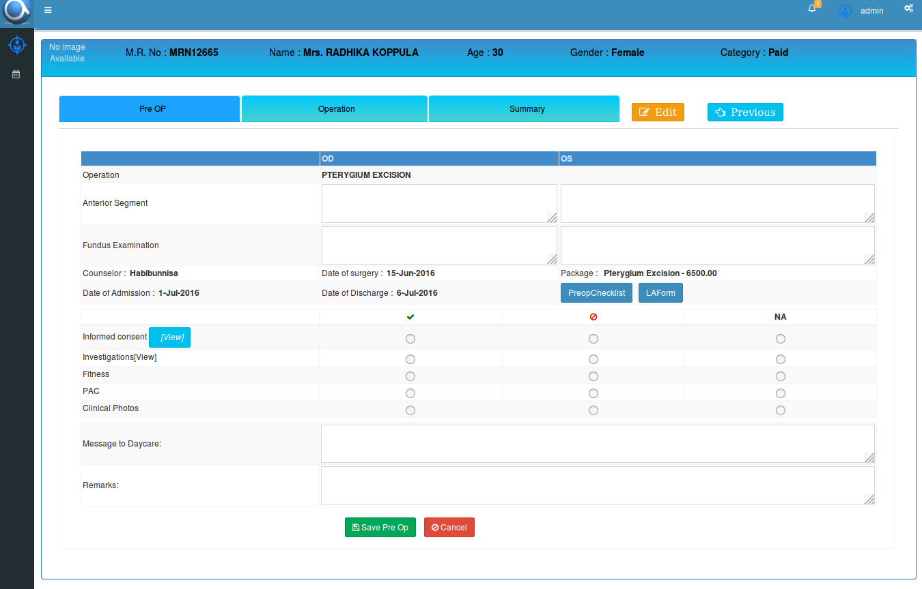
OT Management
The following screens will explain the OT management

Slide 17
OT Management

