Slide 1
Hospital Information Management System (HIMS)

Slide 2
HIMS
This application covers end to end functionality of small to large hospital
The modules covered in this application are
Out Patient
Pharmacy
Lab
In-Patient
Nursing
Operation Theater Management

Slide 3
Out Patient Management:
This module maintains complete data of patients with high quality reports.
This module maintains complete medical record, patient prescription with investigations and treatment details.
Our Speech to Text feature helps doctors in documenting Doctor notes
Our Corporate Registration feature for credit patients helps in handling Corporate Out Patients.

Slide 4
Patient Management
Initial Setup
Out Patient
Corporate
Registration
Reports
1.Allergy Setup
2.Procedur Setup
1.Patient Queue
2.Appointments
3.View Bills
4.Patient TAT
1.Corporate
Registration
2.Credit Lab Billing
1.Dash Board
2.Patient Reports
3.Revenue Reports
1.Initially allergies and procedures have to be set up. Doctors and employees are also registered.
2.Doctor availability and service charges also set for the doctors before generating appointment to the
Patient.
3. Our reports cover patient details day-wise, month-wise and year-wise.

Slide 5
Out Patient Screen Flow

Slide 6
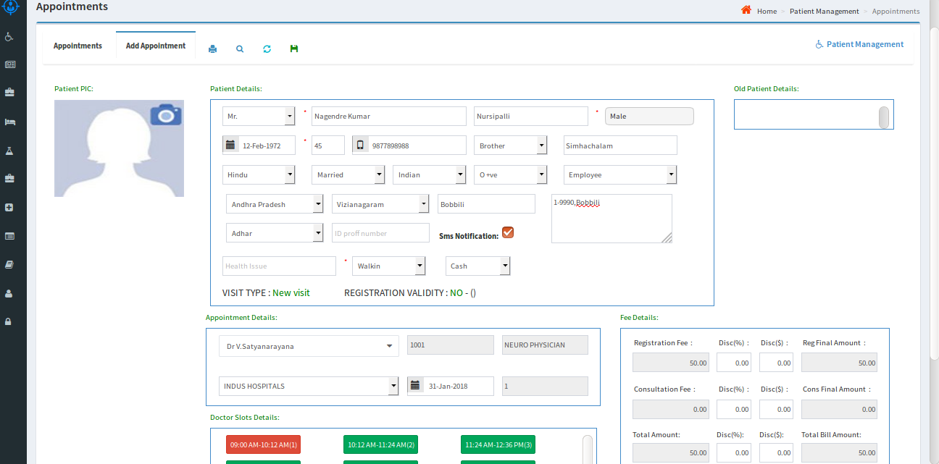
OUT PATIENT
Patient Queue: By using this page new patients can be registered and appointments for those patients can be generated at a selected time-slot.
Appointments for old patients with valid registration can also be generated.
Doctor availability slots can also be updated in the system depending on the availability of the doctor.

Slide 7
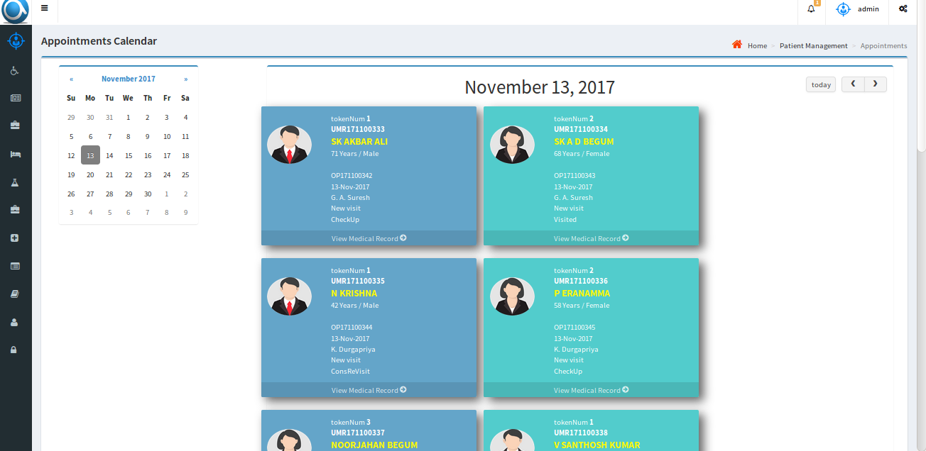
Appointments
Appointments: By using this page Day-wise appointments for particular doctor can be viewed.
Patient image along with other details like medical record can be accessed.

Slide 8
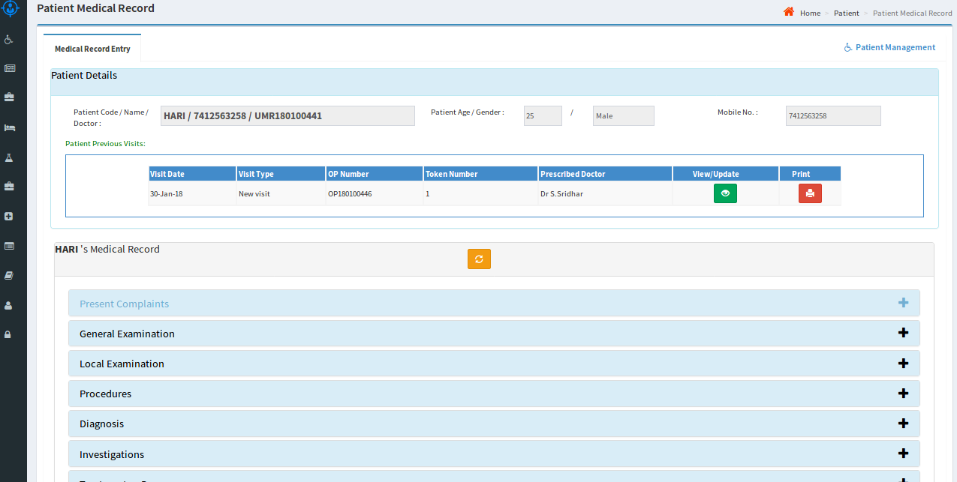
Medical Record
Medical Record: Complete patient medical record can be accessed from this page.
The doctor can use Speech to Text feature to write notes, prescription etc.,

Slide 9
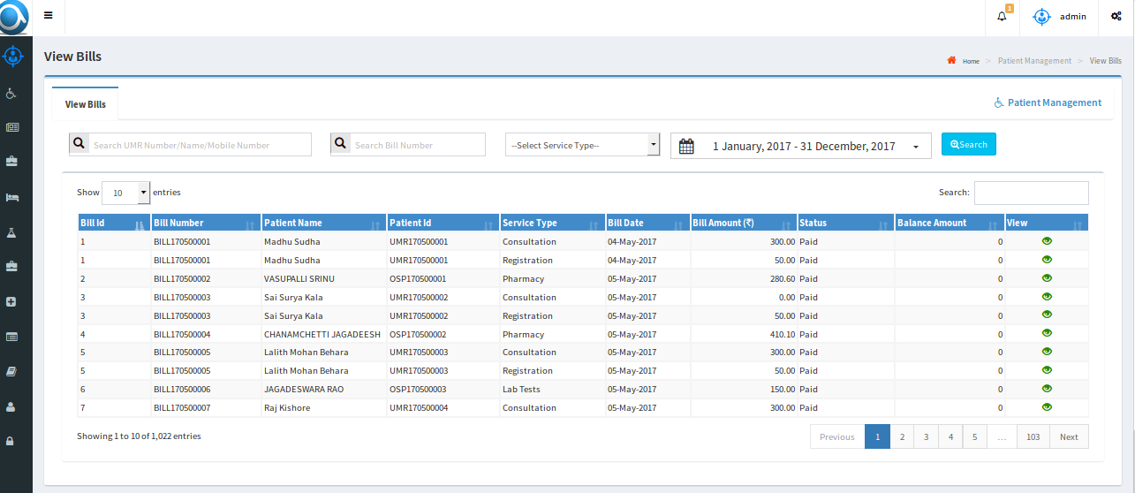
View Bills
View Bills: All bills for a selected period along with patient appointments and registrations are displayed.
Detailed view is also available for a selected list item.

Slide 10
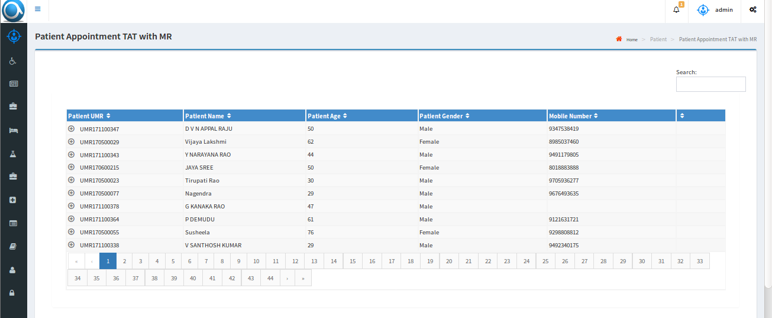
TAT Report
Tat report: Here we have detailed report of the patients about how much time they spent in hospital, including lab and pharmacy.

Slide 11
Pharmacy

Slide 12
Pharmacy
We have two flavors of pharmacy application, one for independent pharmacy and one for pharmacy associated with a hospital.
This application covers end to end flow from receipt of stock from stockiest to selling of drugs, billing with GST, alert with list of drugs which reached below the defined threshold limit, various reports encompassing current stock, sales for a selected period etc.,
Our advanced option supports Multi-location pharmacies, return of purchased drugs with credit voucher option, SMS alerts to registered patients

Slide 13
Diagram:
PHARMACY MODULE
Initial Setup
Stock Inventory
Drug Issue & Bills
Reports
Stock Setup
Drug Setup
Generic Setup
Pharmacy Sales
Sales Returns
Stock Invoice
Stock Receipts
Return Stock
Sales Reports
Purchase
Report
Stock & Sales
Report
Expiry Drugs
Reports
Reorder
Reports

Slide 14
Pharmacy Screen Flow

Slide 15
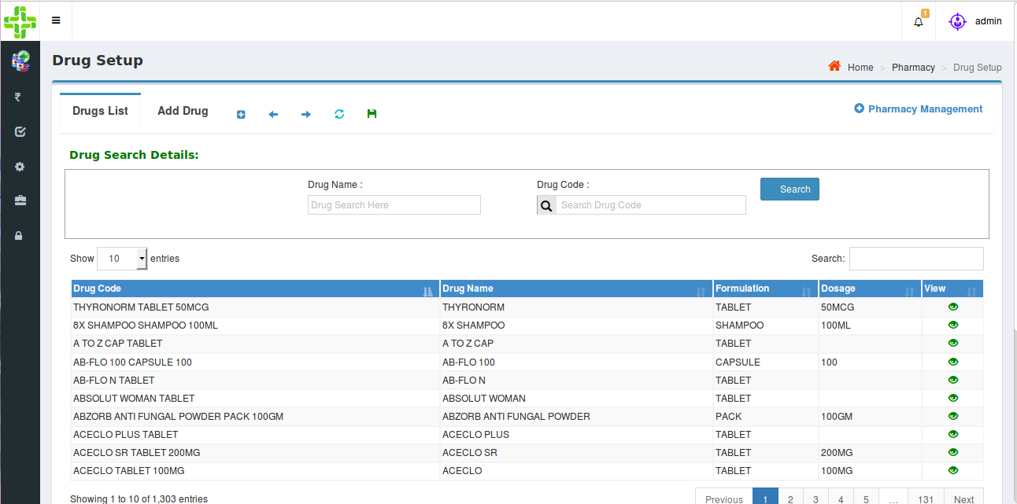
Pharmacy Flow
Drug Setup:
Users can add drug details as well as Generic drugs and setup threshold limit for each drug.
Users can view/edit all the entered drug details.
INPUT PARAMETERS : Drug Name, Formulation, Dosage, HSN Code, MRP, GST %
OUPUT PARAMETERS : Identical to input parameters, which navigates to stock
receipts, sales and report screens.

Slide 16
Pharmacy Flow
Stockist Setup:
- Users can add the details of Stockists.
- Users can view/edit all the entered Stockists.
INPUT PARAMETERS – Stockist Name, GST Number, Contact Details.
OUTPUT PARAMETERS – Stockist Name, which navigates to Stock Invoice.
Generic Setup:
- A drug without brand name is a Generic. Every individual drug has its own generic name.
- Users can add, edit the generics.
INPUT PARAMETERS - Generic Name.
OUTPUT PARAMETERS - Generic Name navigates to Drugs Setup Screen.

Slide 17
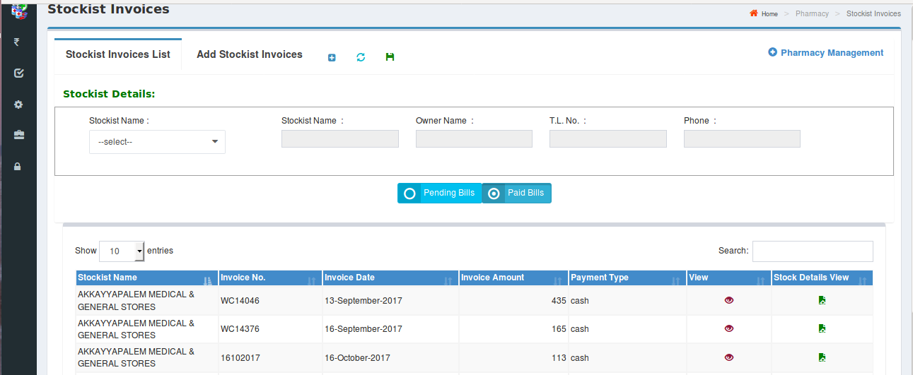
Pharmacy Flow
Stock Invoice:
- Users can add invoices for selected stockist
- Users can view invoices; invoice details and drug details entered under particular invoice
INPUT PARAMETERS – Invoice Number, Invoice Date, Gross Amount, Payment Type, Discount
Percentage, Discount Amount, SGST Amount, CGST Amount, GST Amount, Final Invoice Amount.
OUTPUT PARAMETERS – Identical to input parameters, navigates to Stock Receipts and Return
Stock.

Slide 18
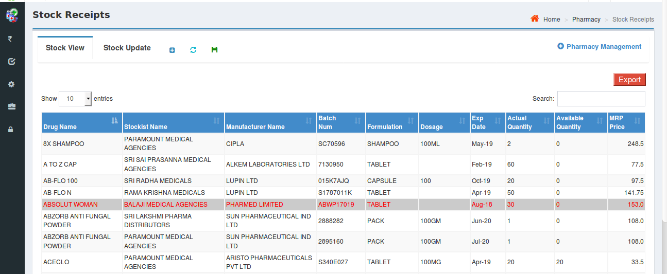
Pharmacy Flow
Stock Receipts:
- Users can enter details of received stock depending on the respective stockiest and
invoice number.
INPUT PARAMETERS - Batch Number, Expiry Date, Quantity, MRP, Distributor Amount.
OUTPUT PARAMETERS - Identical to input parameters, navigates to Sales, Return Stock
and Reports respectively.
Drugs which are about to expired are indicated with a specific color.

Slide 19
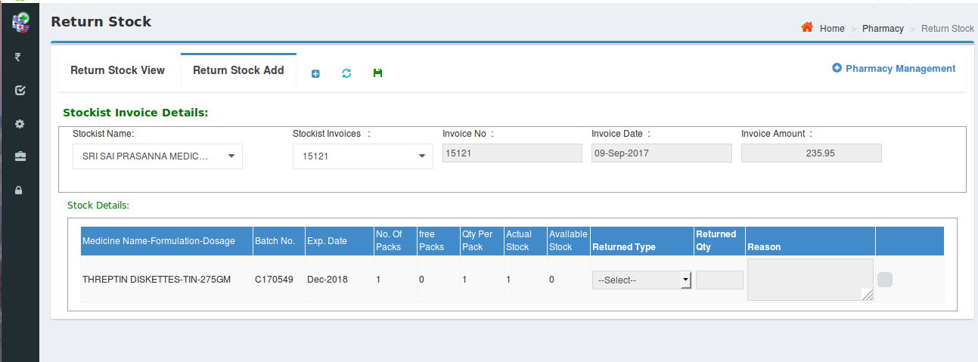
Pharmacy Flow
Return Stock:
The retail pharmacy user can return drugs to the stockiest either fully or partially under selected invoice.
Returned stock can either be damaged or not moveable drugs.

Slide 20
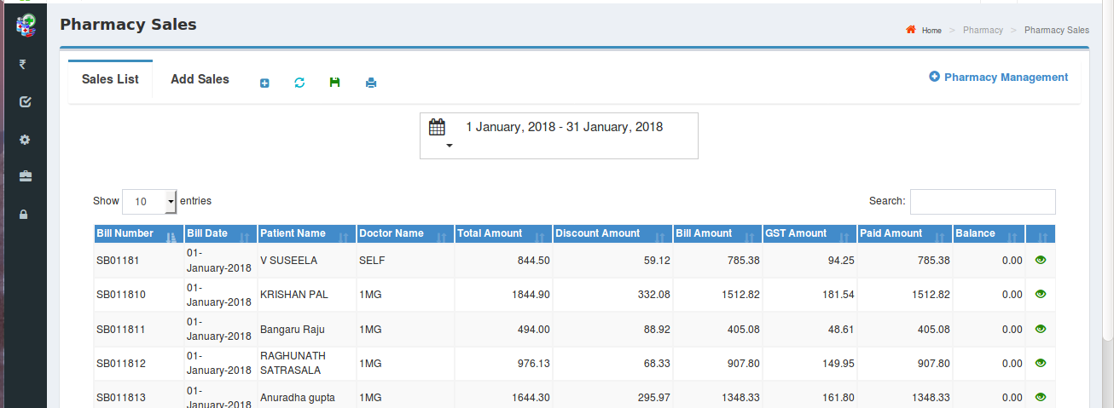
Pharmacy Flow
Pharmacy Sales:
- The retail sale details along with the details of the patient can be captured.
- The details of retail sales for a selected time period can be viewed.

Slide 21
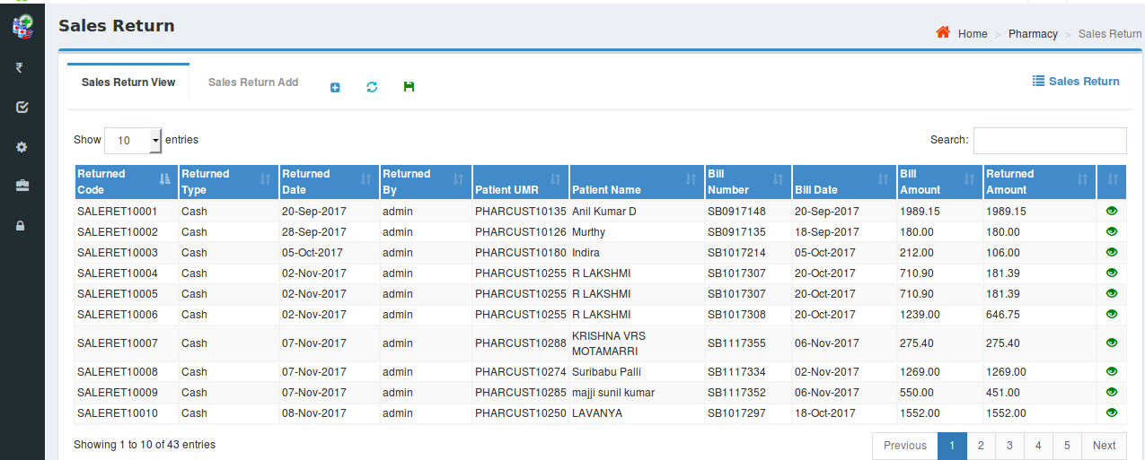
Pharmacy Flow
Sales Return:
- The details of the returned medicines by a patient can be captured
- The list of returned medicines along with other details can be viewed

Slide 22
Pharmacy Flow
Reports:
Our application covers various kinds of reports and some of them are as follows:
Sales Report: Summary and detailed description of sales for a selected referral/Doctor and for a selected time period.
Purchase Report: Summary and detailed description of the purchases for a selected time period.
Stock and Sales Report: Drug wise purchased quantity/value, sales quantity/value, stock and ‘Value of stock on hand’ are populated in this report
Expiry Drugs Report: Details of expired drugs are generated in this report.
Re-order Report: The list of drugs whose quantity is below the threshold limit are displayed so as to be re-ordered
All reports have options to ‘Export to Excel’ and ‘Export to Pdf’

Slide 23
Pharmacy Reports

Slide 24
Pharmacy Reports

Slide 25
Medical Lab

Slide 26
Medical lab
We have two flavors of lab application, one for basic lab for small labs covering basic tests and one for advanced lab covering advanced tests.
Our lab application covers functionality for independent lab as well as lab associated with a hospital with functionality to associate lab results with patient record which is helpful to maintain a record of the patient’s lab results for necessary retrieval any time.
Our lab application covers end to end functionality from patient registration to completion of tests including lab billing, storage of lab test results etc.,
Our lab application covers various reports encompassing patient lab report history, referral doctor wise reports, Billing details reports etc.,

Slide 27
Lab Screen Flow

Slide 28
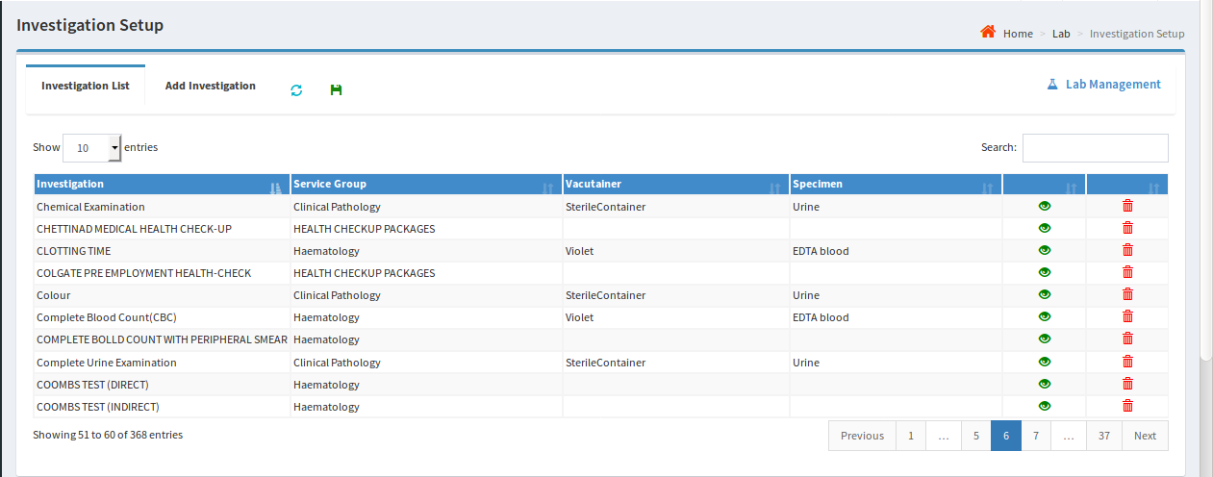
Lab Flow
Initial Setup:
The following entities can be set up through Atri’s Lab application
Department : Internal departments can be added, viewed and edited like Laboratory, X-ray, Radiology etc.,
Service Group : Service groups can be added for multiple investigations. User can view and update.
Vacutainer : User can add, view and update containers to collect samples.
Specimen : User can add, view and update samples like Blood, Urine, Sputum etc.,
Investigation : Investigations can be added by mapping all above i.e., department, service group, vacutainer and specimen. And user can view and update existed list of Investigations.
Investigation Parameter: Individual parameters are mapped to respective investigation.
Package: Mapping of multiple service groups to respective investigations.

Slide 29
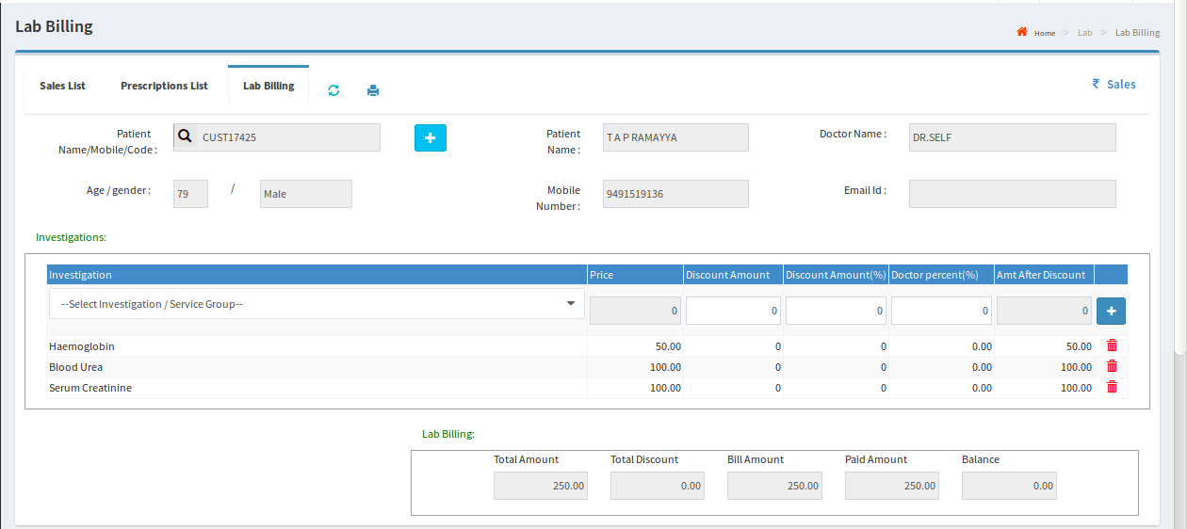
Lab Billing
Patient details and Lab test details are captured and the patient is billed for the identified tests.
Once payment is done, status will change from pending to paid.

Slide 30
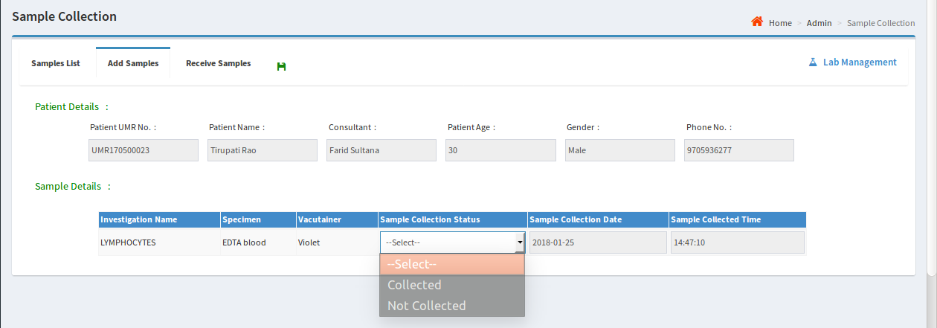
Sample Collection
Once Billing is done, the patient will go for sample collection.
The status of the sample will be updated to ‘Collected’ as soon as the sample is collected.

Slide 31
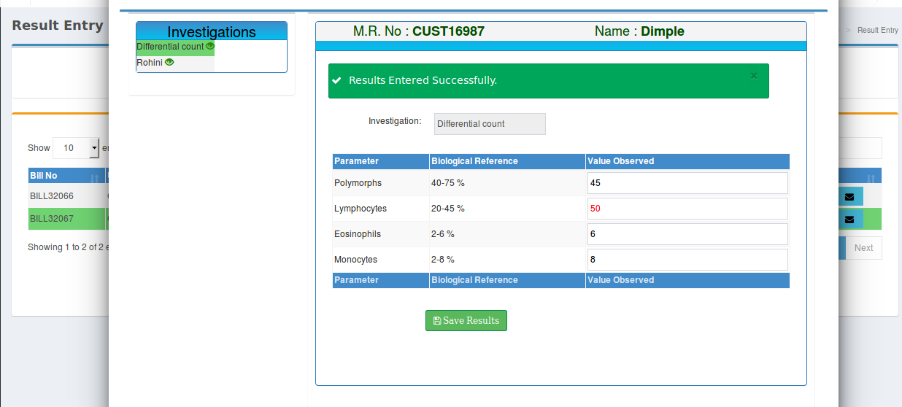
Result entry
After tests are done, results are entered using the following screen

Slide 32
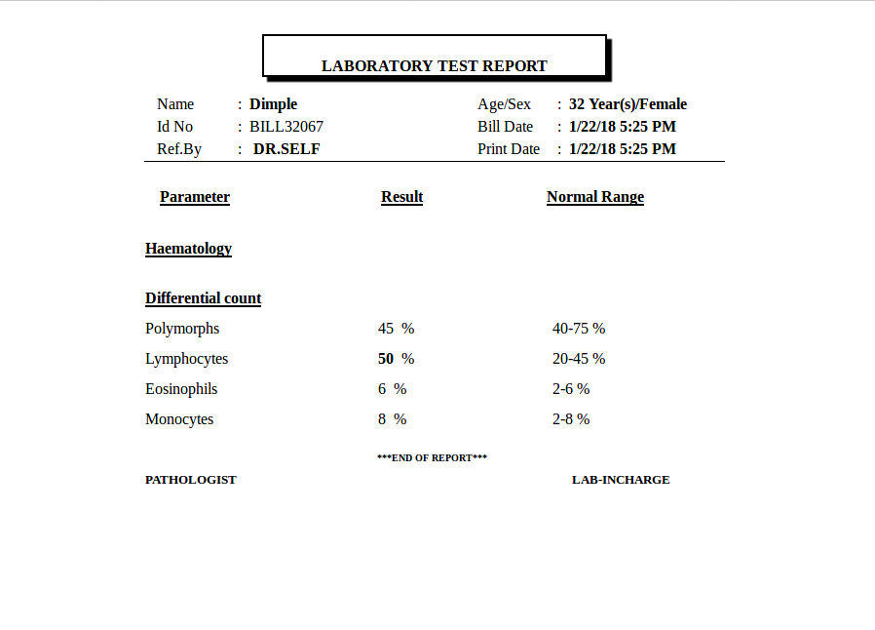
Result View
After saving the results of investigations, user can take printout of the report.

Slide 33
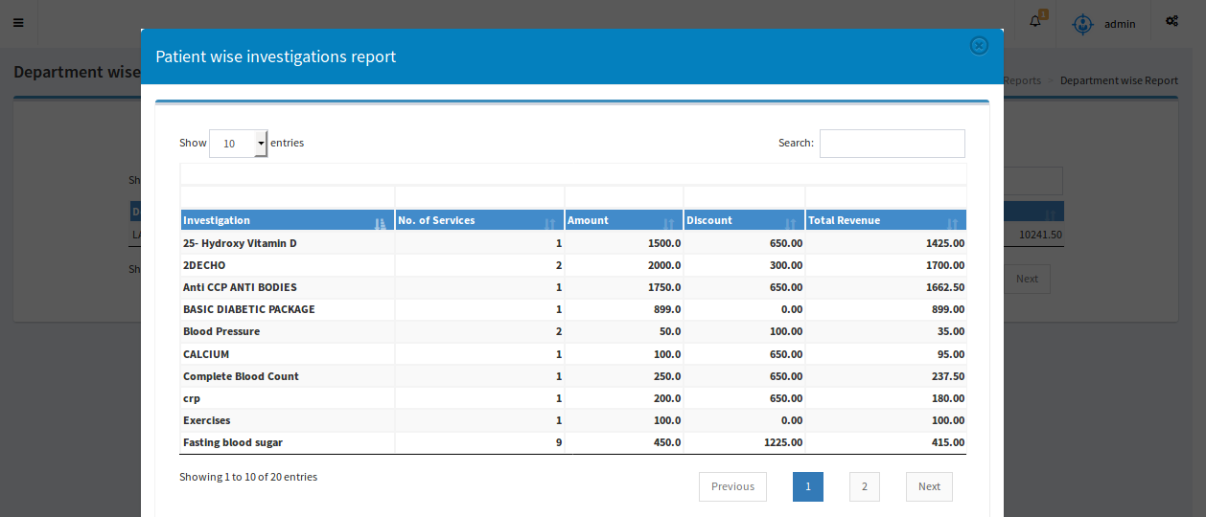
Reports
Our application covers various kinds of reports and some of them are as follows:
Revenue Report: Displays total income for a selected time period.
Doctor wise Report: Displays doctor wise total income for a selected time period.
Department wise Report: Individual department with multiple investigations reports are listed.

Slide 34
In Patient (IP)

Slide 35
In Patient
Registration of patients as In-Patients through the system
Provision to set up beds at appropriate locations in the hospital along with applicable charges
Provision to generate advance bill
Can generate list of due payments for selected period of time
Bill of the selected In-Patient along with details of all the services received by the patient along with the charges are displayed

Slide 36
In Patient Screen Flow

Slide 37
Bed Setup

Slide 38
IP Registration

Slide 39
IP Advance Bill

Slide 40
IP Billing

Slide 41
IP Services Log

Slide 42
Operation Theatre Management(OT)

Slide 43
Operation Theatre Management
Operation theatre module is designed to schedule and managing various surgeries in the hospital.
Operation theatre module is integrated with other modules for smooth management of pre and post operative care for the patient.
All the scheduled surgeries along with patient and doctor details are displayed for the selected date.
This module helps in changing of surgeons in case of non-availability of assigned surgeon.
This module supports on-line case-sheet management.

Slide 44
Operation Theatre Management Screen Flow

Slide 45
OT Set Up
Theatre Master Setup: New theatre along with charges can be added, viewed and existing theatre details can be updated.
Equipment can be added or deleted or updated for a selected theatre.

Slide 46
OT Set Up
Surgery Master Setup: Various types of surgeries along with applicable charges can be set u.
Existing surgeries can be deleted or modified if needed.
Drugs, equipment and roles are assigned to the respective surgery and the enterd values are populated in OT Scheduling.

Slide 47
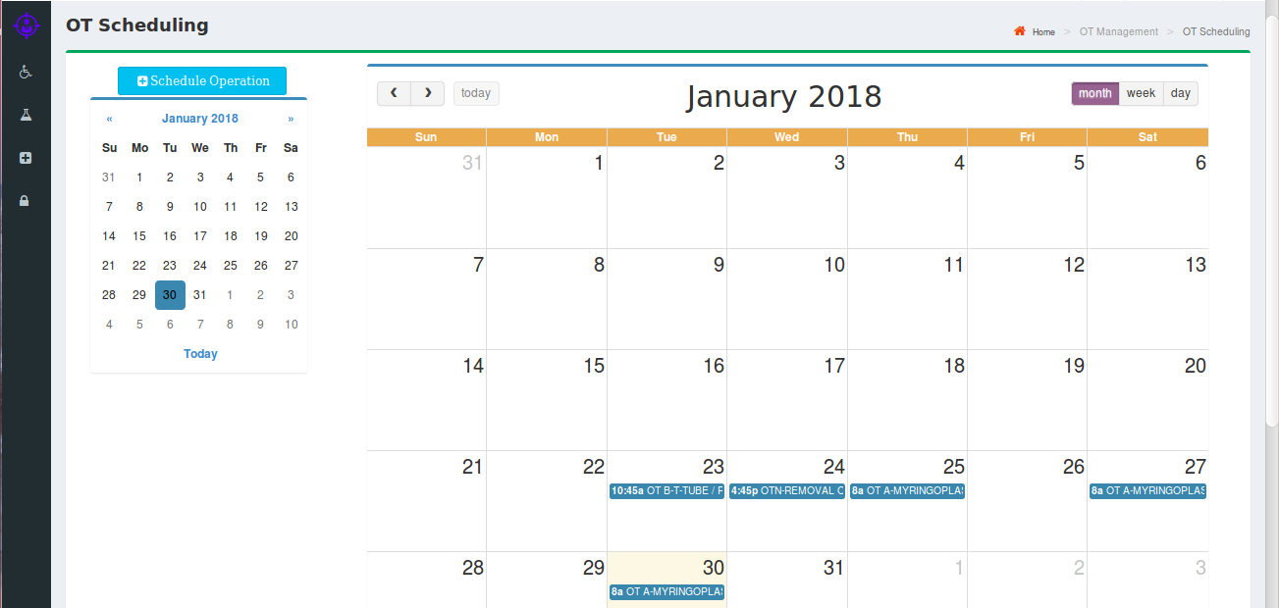
OT Scheduling
Surgeries can be scheduled in a selected theatre for a particular patient on a scheduled date.
User can view the list of surgeries scheduled on monthly, weekly or daily basis as selected.

Slide 48
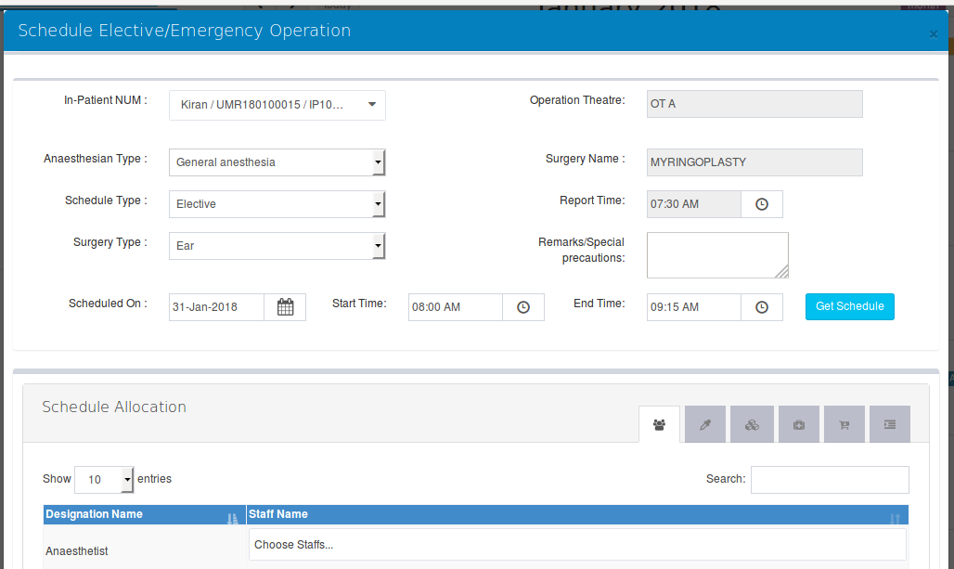
Scheduling Elective/ Emergency Operation
For selecting Elective/Emergency Surgery, the respective patient is selected from the list and other details like type of Anesthesia, type of surgery (Elective or Emergency), scheduled start and end times of the surgery, are entered into the system.

Slide 49
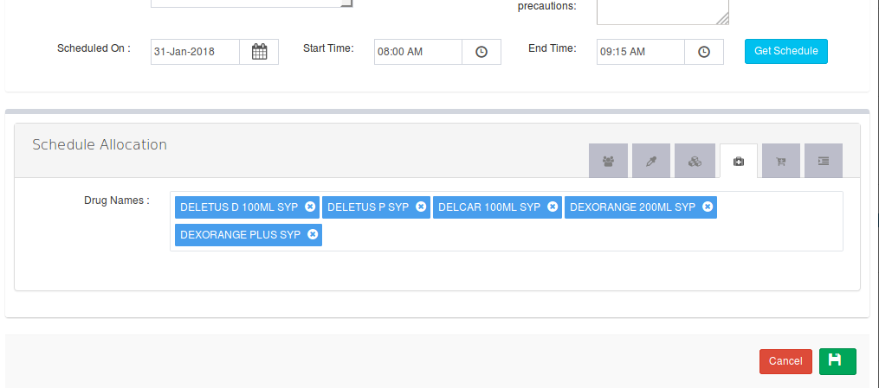
Schedule Allocation
In addition to assignment of surgeon for a surgery, other personnel, equipment and drugs can be assigned.

Slide 50
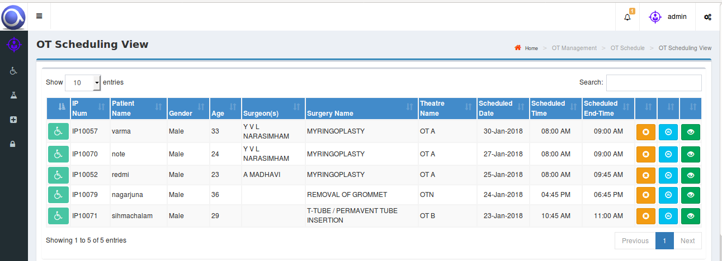
OT Schedule Flow
OT schedule along with patient details can be viewed and the user can edit the details.
In case of un-availability of Theatres, user can shift the surgery to other Theatre.

Slide 51
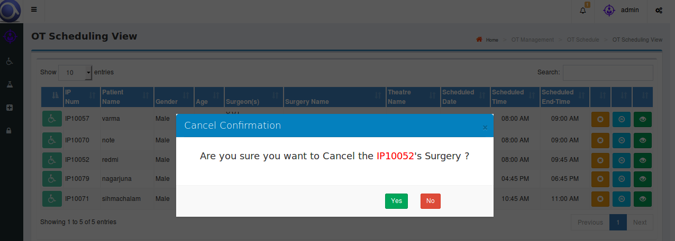
Cancellation Of Surgery
In case of cancellation of surgery on patients request, user can cancel the surgery.
Once surgery is done and case sheet is entered, the surgery can’t be cancelled in the system.

Slide 52
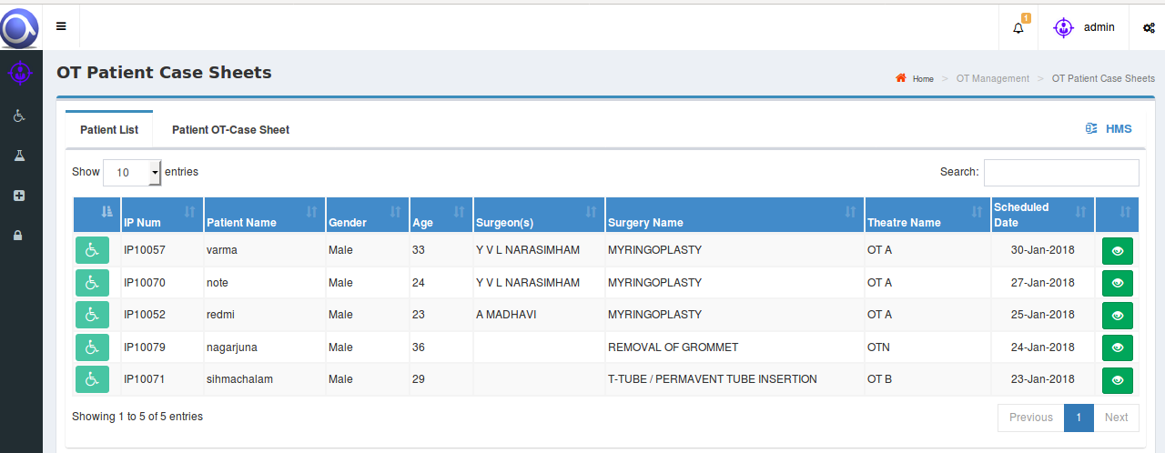
Case Sheet
Once surgery is done, patient will be under post-operative care for a few days and during this period, case sheet will be maintained for each patient.

Slide 53
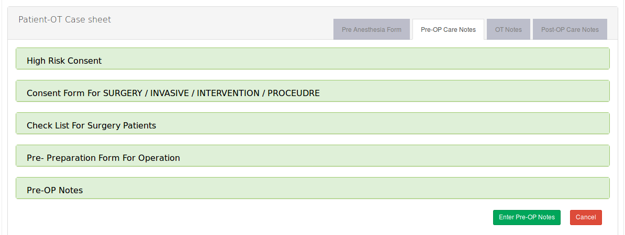
Pre-Anaesthesia Form
Pre-Anaesthesia form is filled before each surgery.

Slide 54
OT Notes
There is provision for maintaining OT notes.

Slide 55
Nursing
This module helps in maintaining various forms like Nurse Assessment form, Doctor Assessment form etc.,
There is provision for maintaining Vitals, Doctor visit details, Nurse Notes, Allergy Details, Drug details, Investigation details etc.,
This module helps in managing Cross Consultancy, complete details of IP Services used etc.,
This module helps in managing Bed Transfer if the patient requests for the same

Slide 56
Nursing Screen Flow

Slide 57
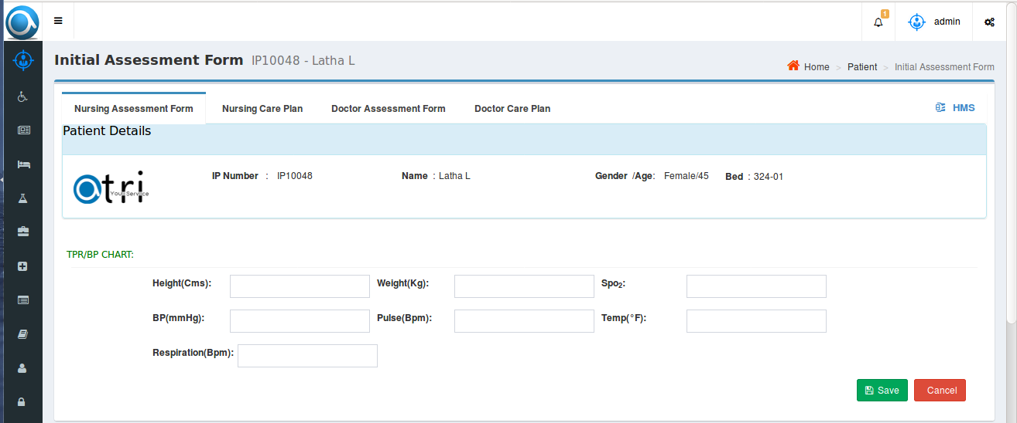
Initial Assessment Forms
Nurse Assessment Form: Basic Health details are noted by Nursing Staff. The entered data can be updated if necessary.
Nursing Care Plan: User will enter investigations to be recorded and their effectiveness assessed.
Doctor Assessment Form : Current Medical History and describes recent changes in health, hospitalizations, falls, etc., in the past 6 months
Doctor Care Plan : Based on Doctor’s treatment plan, user will enter the diagnosis and care plan of the patient.
Nutrition Plan : User will enter Hygiene diet to be followed by the patient.

Slide 58
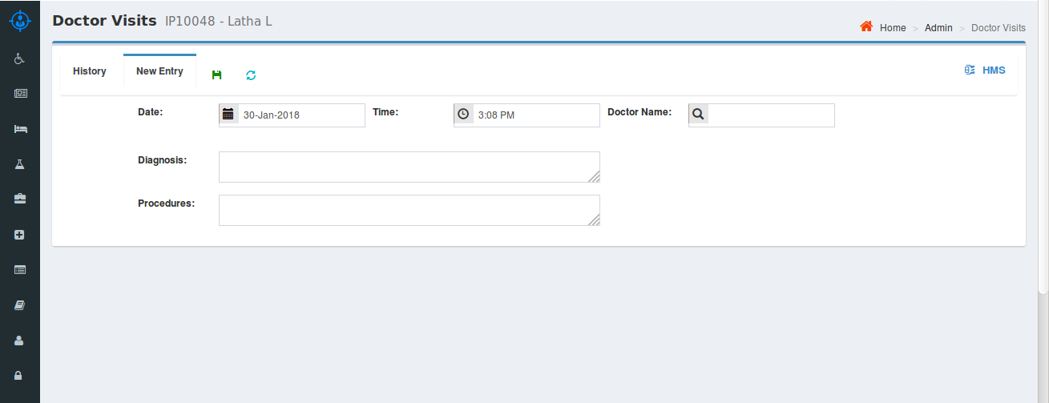
Vitals: Vitals will be entered at specified time intervals.
Doctor Visits : User will enter the details of the Doctor’s visits and if any diagnosis or procedures given by the respective Doctor.
Nurse Notes : Nurse will enter the details based on patients condition.

Slide 59
Allergies: If patient has any allergies, the same will be entered into the system.
Drug Inputs : Details of all the drugs prescribed and given to the patient will be entered into the system.
Investigations : All the investigation details will be entered into the system.

Slide 60
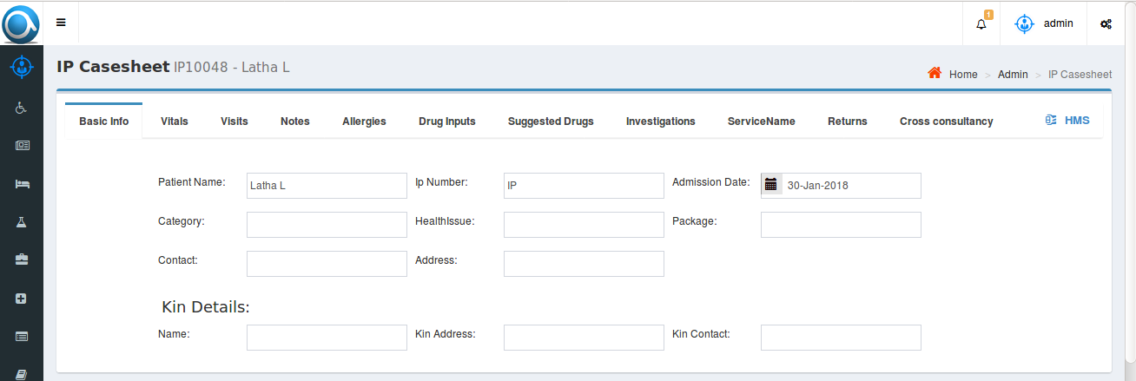
Case Sheet: The complete case sheet of the patient will be maintained in the system.

