Slide 1

Vital Status Application

Slide 2
Pre-Natal Diagnostic Techniques (PCPNDT) Act,1994
Female foeticide in India
  This process began in the early 1990s when ultrasound techniques gained widespread use in India. There was a tendency for families to continuously produce children until a male child was born. Foetal sex determination and sex selective abortion by medical professionals has today grown into a Rs. 1,000 crore industry (US$ 244 million). Social discrimination against women and a preference for sons have promoted female foeticide in various forms skewing the sex ratio of the country towards men. According to the decennial Indian census, the sex ratio in the 0-6 age group in India went from 104.0 males per 100 females in 1981, to 105.8 in 1991, to 107.8 in 2001, to 109.4 in 2011. The ratio is significantly higher in certain states such as Punjab and Haryana (126.1 and 122.0, as of 2001). According to 2011 Population Census, the overall ratio changed to 940 females per 1000 males.
Objective of this Act:
  The in-balance between male to female ratio has reached an alarming stage that Indian Govt. has to intervene and put strict laws in place to curtail female foeticide. Hence Pre-Conception and Pre-Natal Diagnostic Techniques (PCPNDT) Act, 1994 is enacted to stop female foeticides and arrest the declining sex ratio in India. The act banned prenatal sex determination.
  The main purpose of enacting the act is to ban the use of sex selection techniques after conception and prevent the misuse of prenatal diagnostic technique for sex selective abortion.

Slide 3
Pre-Natal Diagnostic Techniques (PCPNDT) Act, 1994
Salient features of the Act:
  Offences under this act include conducting or helping in the conduct of prenatal diagnostic technique in the unregistered units, sex selection on a man or woman, conducting PND test for any purpose other than the one mentioned in the act, sale, distribution, supply, renting etc. of any ultra sound machine or any other equipment capable of detecting sex of the foetus. Main provisions in the act are
  The Act provides for the prohibition of sex selection, before or after conception.
  It regulates the use of pre-natal diagnostic techniques, like ultrasound and amniocentesis by allowing them their use only to detect :
    genetic abnormalities
    metabolic disorders
    chromosomal abnormalities
    certain congenital malformations
    haemoglobinopathies
    sex linked disorders.

Slide 4
Features and impact of (PCPNDT) Act, 1994
Salient features of the Act:
  No laboratory or center or clinic will conduct any test including ultrasonography for the purpose of determining the sex of the foetus.
  No person, including the one who is conducting the procedure as per the law, will communicate the sex of the foetusto the pregnant woman or her relatives by words, signs or any other method.
  Any person who puts an advertisement for pre-natal and pre-conception sex determination facilities in the form of a notice, circular, label, wrapper or any document, or advertises through interior or other media in electronic or print form or engages in any visible representation made by means of hoarding, wall painting, signal, light, sound, smoke or gas, can be imprisoned for up to three years and fined Rs.10,000.
Whom does this Act impact:
  Genetic Counselling Centre, Genetic Laboratory or Genetic Clinic

Slide 5
Appropriate Authorities
Human Resource Requirement at Three Levels:
  National level, the Mission Steering Group(MSG) chaired by the Union Minister of Health and Family Welfare shall oversee the implementation of the PC&PNDT Act.
  At State level, the State Health Mission (SHM), chaired by the Chief Minister shall oversee implementation of the program. The Director, the Nodal Officer for RCH II will be the implementing officer at the state level.
  At district level District Implementation Coordinator under the guidance of District Nodal Officer(CMO) shall oversee the implementation of the PC&PNDT Act.

Slide 6
Implementation of the Act
Registration:
  All bodies under the PNDT Act namely Genetic Counselling Centre, Genetic Laboratory or Genetic Clinic should be registered by submitting application to the Chief Medical Officer of the district; or any other medical officer constituted as appropriate authority (AA).
Renewal of Registration:
  Every certificate of registration shall be valid for a period of five years since its issuance. Thirty days before the date of expiry of the certificate of registration a fresh application for a certificate of Registration should be made.

Slide 7
Implementation of the Act
Maintenance and Preservation of Records:
  Register showing in serial order:
    names and addresses of men or women given genetic counselling and/or subjected to pre-natal diagnostic procedure or test;
    names of their spouses or fathers;
    date on which they first reported for such counselling, procedure or test.
  Forms to be maintained
    Record by every Genetic Counselling Centre of each woman counselled is to be as specified in FORM D under the Rules;
    Record by every Genetic Laboratory of each man or woman subjected to prenatal diagnostic test is to be as specified in FORM E under the Rules;
    Record by every Genetic Clinic of each man or woman subjected to pre-natal diagnostic procedure is to be as specified in FORM F under the Rules.
  Other Records
    • Case records • Forms of consent • Laboratory results • Microscopic pictures • Sonographic plates or slides • Recommendations and letters

Slide 8
Implementation of the Act
Records to be submitted to Appropriate Authority
  every Genetic Counselling Centre, Genetic Laboratory, Genetic Clinic, Ultrasound Clinic and Imaging Centre shall send a complete report in respect of all preconception or pregnancy related procedures/techniques/tests conducted by them in respect of each month by 5th day of the following month to the concerned Appropriate Authority.
  These records are required to be maintained for a period of 2 years from the date of completion of counseling, pre-natal diagnostic procedure or pre-natal diagnostic test or in the event of any legal proceeding, till the final disposal of the legal proceeding.
  In case the records are maintained on computer or other electronic equipment, a printed copy of the record is required to be taken and preserved after authentication by a person responsible for such record.
  Records, at all reasonable times are to be made available for inspection to Appropriate Authority or person authorized by the Appropriate Authority in this behalf

Slide 9
Implementation of the Act
Records to be maintained by Appropriate Authority
  Some other records to be maintained by Appropriate Authority
    applications for grant of certificate of registration;
    applications for renewal of certificate of registration as specified in Form H under the Rules;
    letters of intimation of every change of employee, place, address and equipment installed

Slide 10
Atri’s Vital Status Application
Background:
  We built Vital Status application covering important requirements from the perspective of Genetic Counselling Centre, Genetic Laboratory, Genetic Clinic, Ultrasound Clinic and Imaging Centre to remain in compliance with Pre-Conception and Pre-Natal Diagnostic Techniques (PCPNDT) Act, 1994.
Salient Features of our Vital status application:
  This is for labs where pregnancy related tests are done and form ‘F’ (Form for Maintenance of Record in Respect of Pregnant woman by Genetic clinic/Ultrasound clinic/Image Centre) to be submitted to Appropriate Authority declaring that the test results were not used for determination of sex of the foetus.
  This application covers Patient registration, necessary online forms to record scan results for 11 possible scans that can be performed on a pregnant woman, online form ‘F’

Slide 11
Atri’s Vital Status Application
  This application helps in preparing necessary bundle to be submitted to Appropriate Authority on a monthly basis which consists of summary sheet with details of all the pregnant woman who got scanned in the facility and form ‘F’ for each applicable candidate signed by the patient and the doctor.
  This application maintains test results in the database which can be retrieved efficiently through search option thus saving paper and making it easy to demonstrate necessary proof during any audit by Department of Health.
Depending on the stages of pregnancy, to know the growth of the baby at certain intervals, many scans are done for the pregnant women and our application captures the details of these scans and populates graphs which can show the growth of the baby.
Our application can be used to know the Estimated Delivery Date(EDD) by using the LMP(last menstrual date) and ultrasound details.

Slide 12
Proposed Application to cover end to end flow of PCPNDT Act, 1994
Required features to cover end to end flow of this Act:
  The application should track the purchase of Genetic Laboratory equipment by new or existing Genetic Clinic
  The application should track the registration/re-registration of Genetic Labs
  The application should be able to maintain the details of the pregnant woman who got scans done at the Genetic Clinic for possible audit along with all reports to be shared with Appropriate Authority in case of an audit.
    Our existing application covers Patient registration, necessary online forms to record scan results for 13 possible scans that can be performed on a pregnant woman, online form ‘F’
    Our existing application maintains test results in the database which can be retrieved efficiently through search option thus saving paper and making it easy to demonstrate necessary proof during any audit by Department of Health.
Note: The text marked in Green covers the existing functionality in our Vital Status application.

Slide 13
Proposed Application to cover end to end flow of PCPNDT Act, 1994
Required features to cover end to end flow of this Act:
  The application should be able to generate necessary set of documents (Patient summary, Form F signed by both the patient as well as the doctor in-charge) at each Genetic Clinic to be submitted to Appropriate Authority.
    Our existing application helps in preparing necessary bundle to be submitted to Appropriate Authority on a monthly basis which consists of summary sheet with details of all the pregnant woman who got scanned in the facility and form ‘F’ for each applicable candidate signed by the patient and the doctor
  The application should be able to accept the above set of documents through the application instead of paper copies.
  The application should be able to generate necessary reports to be submitted by District level authorities to the state level authorities AND State level authorities to the Center level authorities. Acceptance of these reports should be possible in the electronic form through the application instead of hard copies.
Note: The text marked in Green covers the existing functionality in our Vital Status application.

Slide 14
Vital Status Screen Flow

Slide 15
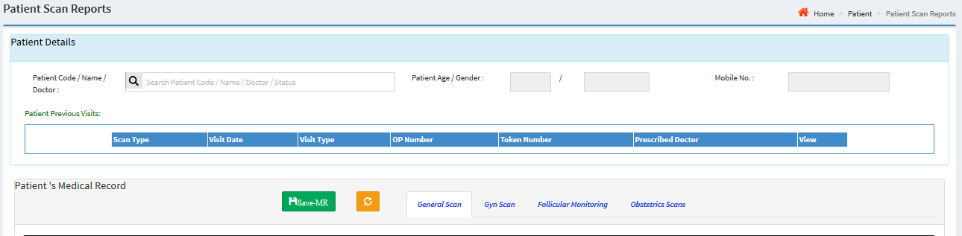
View Patient Details
  Here in this page all the registered patients can be viewed including any old records. Depending on the stages of the pregnancy, following scans are done to the patients.
- General Scan
- Gyn Scan
- Follicular Monitoring
- Obstetrics Scan

Slide 16

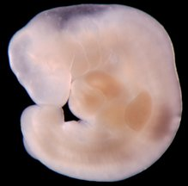
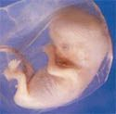

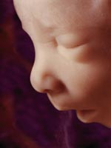

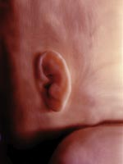
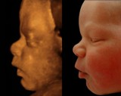
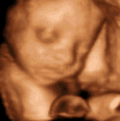
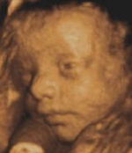


Baby Growth
Pregnancy is broken down into weeks, and is divided into three parts called trimesters.
1st trimester
Month 1-3
Week 1-13
2nd Trimester
Month 4-6
Week 14-27
3rd Trimester
Month 7-9
Week 28-40

Slide 17
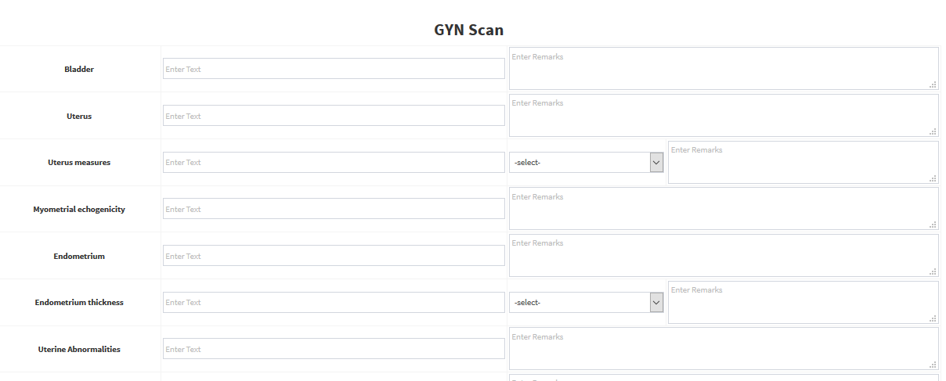
Gynaic Scan
Gynecology scans can help to assist in detecting and monitoring many gynecological conditions like ovarian cysts, Fibroids & polyps etc., The gynaic scan is tab is shown as below

Slide 18
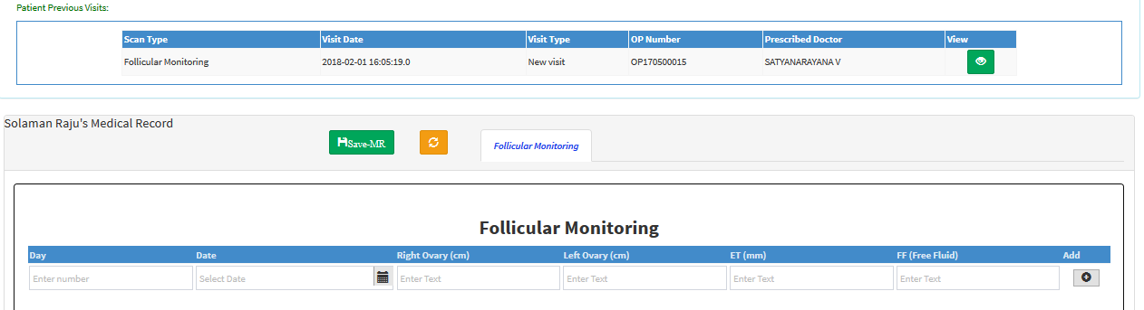
Follicular Monitoring
Follicular Monitoring is the process of serial ultrasonic monitoring of the ovarian follicles used to identify maturation status of eggs. It is useful for assessing the size of the follicle that supports the growing egg and for determining the thickness of the uterine lining. The follicular monitoring tab is shown as below

Slide 19
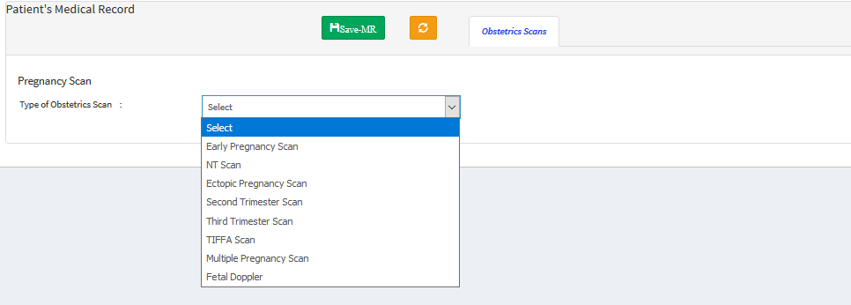
Obstetrics Scan
Obstetrical ultrasound is a useful clinical test to establish the presence of a living embryo/fetus and estimate the age of the pregnancy and diagnose congenital abnormalities of the fetus. Obstetrics scan has 8 different types of scans
    - Early Pregnancy Scan
    NT Scan
    Ectopic Pregnancy Scan
    Second Trimester Scan
    Third Trimester Scan
    Tiffa Scan
    Multiple Pregnancy Scan
    Fetal Doppler

Slide 20
Obstetrics Scan
Early Pregnancy Scan - A pregnancy can be seen from as early as 6 weeks from the first day of your last period (LMP) if the pregnant woman has any problem, then this scan will accurately confirm viability.
NT Scan - The NT scan must be done when the pregnant woman is between 11 and 14 weeks pregnant, because this is when the base of the baby's neck is still transparent.
Ectopic Pregnancy Scan - If no pregnancy can be seen in the uterus but there is evidence of free fluid in the pregnant woman’s abdomen and or a possible 'mass' in the approximate location of one of the pregnant woman’s fallopian tubes, the doctor would then be likely to diagnose a possible ectopic pregnancy.
Second Trimester Scan - A second trimester morphology ultrasound is performed in the middle part of the pregnancy, usually between 18 and 20 weeks gestation. In this screen also we estimate the EDD value by giving LMP date and ultrasound date. The user can also check the growth of the child using parameters like HC,AC,BPD,FL,HL with the help of graphs.

Slide 21
Obstetrics Scan
Third Trimester Scan –
The most common reason for a scan in the third trimester is to check that your baby is
growing normally. In this scan we can see the growth of the baby with the help of the graph
using parameters like HC,BPD,FL,HL,AC. In this stage also we can know the EDD date by
using LMP date and ultrasound date.
Tiffa Scan –
Tiffa scan is important because it detects any congenital abnormalities in the growing fetus. In tiffa scan
also the user can view the growth of the child using graph and can get the date of the EDD using LMP
date and ultrasound date.
Multi Pregnancy Scan –
When the case is like twins, the multi pregnancy scan is done. In this scan page we can know the EDD
date by using LMP date and ultrasound date. In this page we can know the two babies growth with
separate graph for each.

Slide 22
Fetal Doppler Scan
A Doppler scan measures the blood flow through the umbilical cord and around different parts of your baby's body, such as his brain and heart
Graphs:
Here, we can also know the EDD using LMP date and ultrasound date. The growth of the baby is also seen here using graphs with the parameters like Head Circumference (HC) Biparietal Diameter (BPD),Abdominal Circumference (AC),Femoral Length (FL),Humeral Length (HL).We can also view the standard values of the parameters with the respective gestation age.

Slide 23
Obstetrics Scan

Slide 24
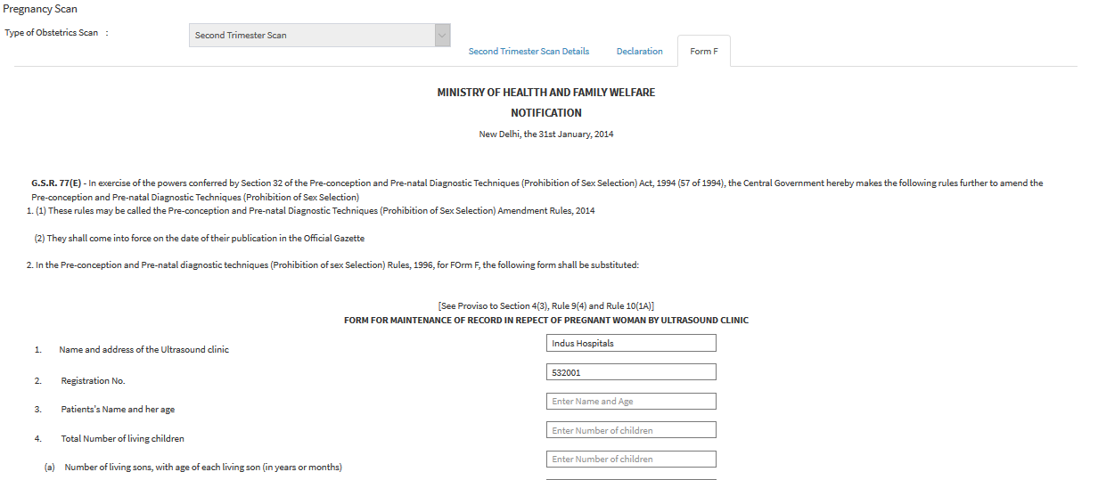
Form F
This form has to be maintained by each and every Genetic Clinic/Lab and submitted to the Govt. as defined by the norms.

Slide 25
Monthly Scan Reports
This screen is used to generate monthly report along with the form ‘F’ to be sent DMHO office for each patient.

Slide 26
Key Benefits of Product or Service
We customize our products to suit your needs
We develop any customized solutions in Java
We design, develop and maintain networks either on full-time basis or part-time basis
We develop customized websites for your needs
Our pricing is very competitive
We provide reliable pre-sales/post-sales support

Slide 27
Next Steps
Send us an email or call us to discuss about your requirements
  We will demo the related product, if we have one and will note down the customization to be done and will send you the same
  If it is a completely new project, we will document the requirements and will send the same to you
Once we have agreement on the customization/requirements, we will send you a proposal with cost, timelines and terms & conditions
Upon acceptance of the proposal, we will start the development
Our development lead will keep in touch with the POC identified from your side to discuss progress and any issues
Once development is complete, we will deploy the application for user acceptance testing
Upon successful completion of user acceptance testing, final product will be deployed at client’s location

Slide 28


