Slide 1
Medical Lab

Slide 2
Medical Lab
We have two flavors of lab application, one for basic lab for small labs covering basic tests and one for advanced lab covering advanced tests.
Our lab application covers functionality for independent lab as well as lab associated with a hospital with functionality to associate lab results with patient record which is helpful to maintain a record of the patient’s lab results for necessary retrieval any time.
Our lab application covers end to end functionality from patient registration to completion of tests including lab billing, storage of lab test results etc.,
Our lab application covers various reports encompassing patient lab report history, referral doctor wise reports, Billing details reports etc.,

Slide 3
Lab Screen Flow

Slide 4
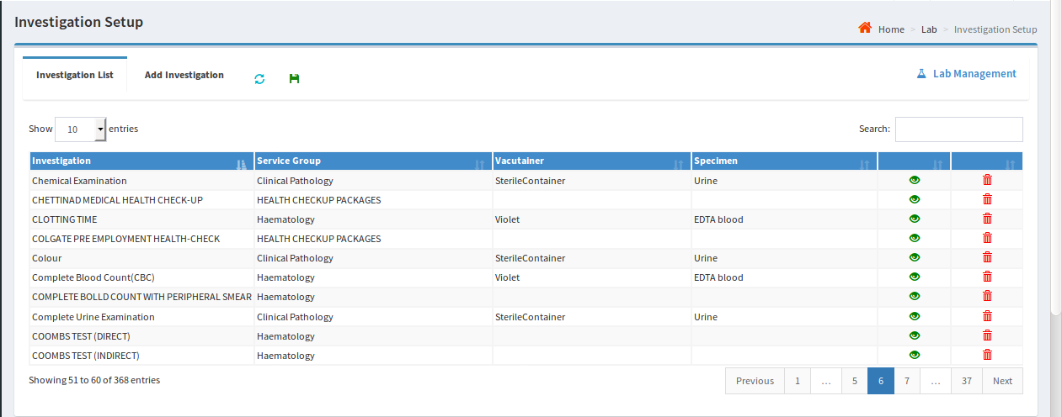
Lab Flow
Initial Setup:
The following entities can be set up through Atri’s Lab application
Department : Internal departments can be added, viewed and edited like Laboratory, X-ray, Radiology etc.,
Service Group : Service groups can be added for multiple investigations. User can view and update.
Vacutainer : User can add, view and update containers to collect samples.
Specimen : User can add, view and update samples like Blood, Urine, Sputum etc.,
Investigation : Investigations can be added by mapping all above i.e., department, service group, vacutainer and specimen. And user can view and update existed list of Investigations.
Investigation Parameter: Individual parameters are mapped to respective investigation.
Package: Mapping of multiple service groups to respective investigations.

Slide 5
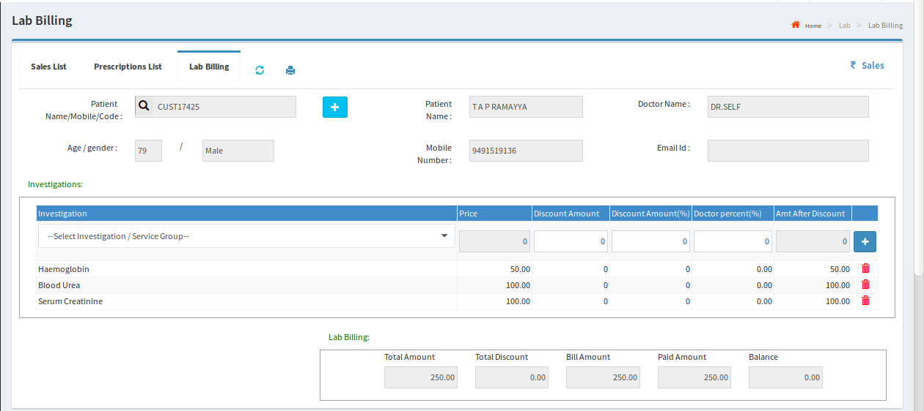
Lab Billing
Patient details and Lab test details are captured and the patient is billed for the identified tests.
Once payment is done, status will change from pending to paid

Slide 6
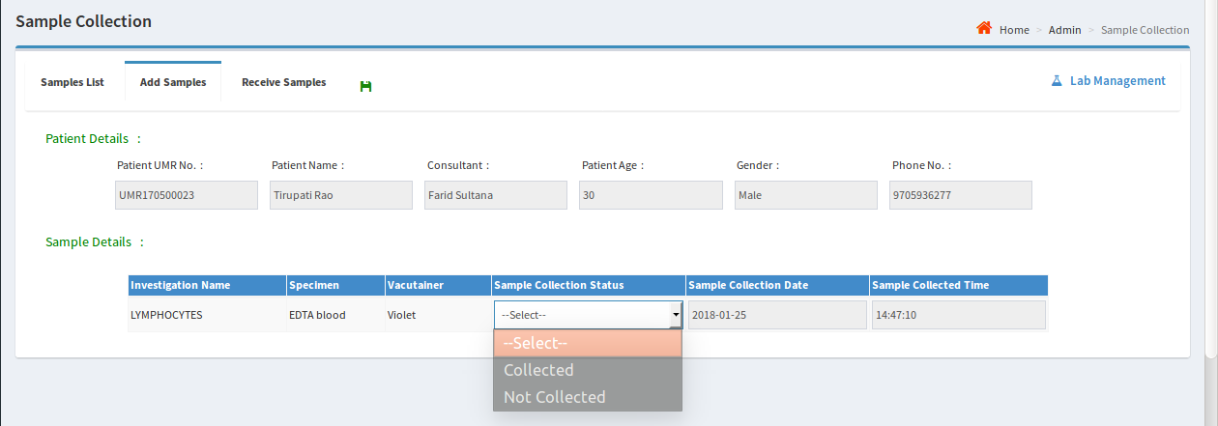
Sample Collection
Once Billing is done, the patient will go for sample collection.
The status of the sample will be updated to ‘Collected’ as soon as the sample is collected.

Slide 7
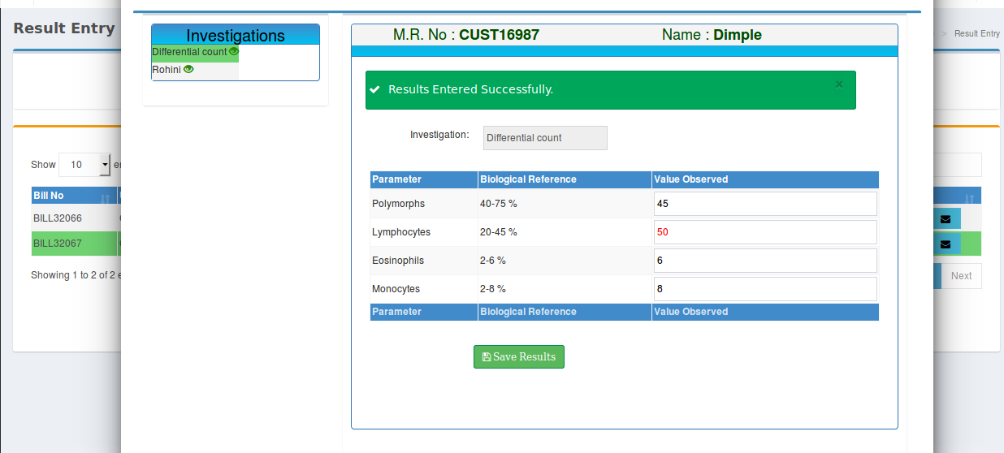
Result entry
After tests are done, results are entered using the following screen

Slide 8
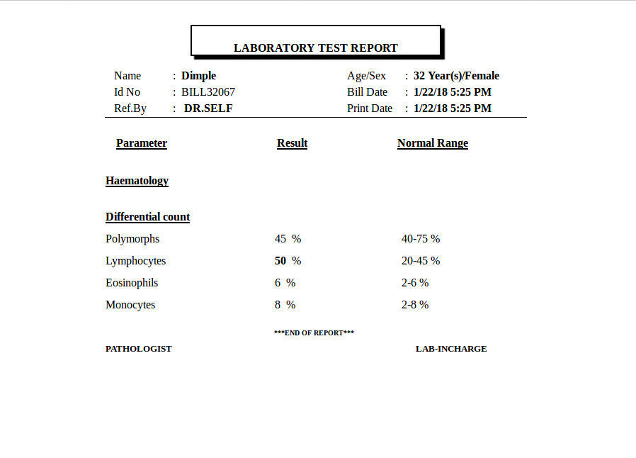
Result View
After saving the results of investigations, user can take printout of the report.

Slide 9
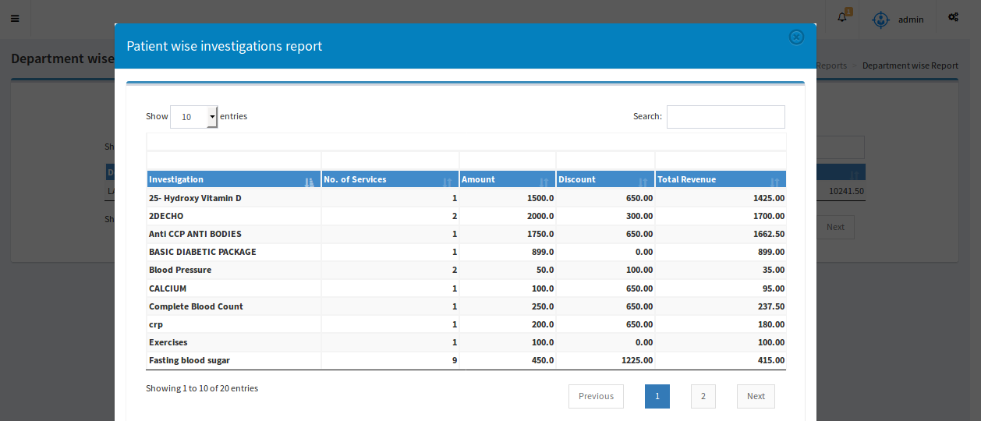
Reports
Our application covers various kinds of reports and some of them are as follows:
Revenue Report: Displays total income for a selected time period.
Doctor wise Report: Displays doctor wise total income for a selected time period.
Department wise Report: Individual department with multiple investigations reports are listed.

