Slide 1
Image Processing

Slide 2
Image processing application
Converts medical scans and x-rays from DICOM to JPEG format and shares these images through the intranet or internet using our application as required. These images can be edited which encompasses zooming, cropping, contrast, brightness etc.,
The images can be accessed from Intranet or Internet thus making it convenient for the doctor to have access to patient’s scans from anywhere and on any device
Patient’s information as well as medical images of the patients can be retrieved based on Patient Id or Patient Name etc.,
The application provides options like editing the image, uploading and downloading of edited images, rotate image and view multiple images on one screen with the help of horizontal and vertical screens including adjustment of brightness, Zoom-In and Zoom- Out, Invert, download of Images.
Voids the necessity to print the images on x-ray films and then to scan them for submission to Arogya Seva for release of funds by directly submitting the JPEG images which are available through this application. This saves considerable cost to the organization in terms of x-ray film and the effort to print and scan the images for submission to NTR Arogya Seva which is exclusively useful in Andhra Pradesh, India.

Slide 3
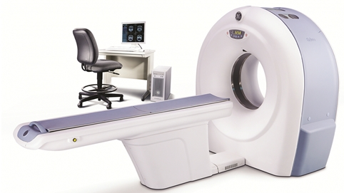
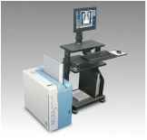
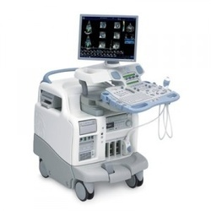
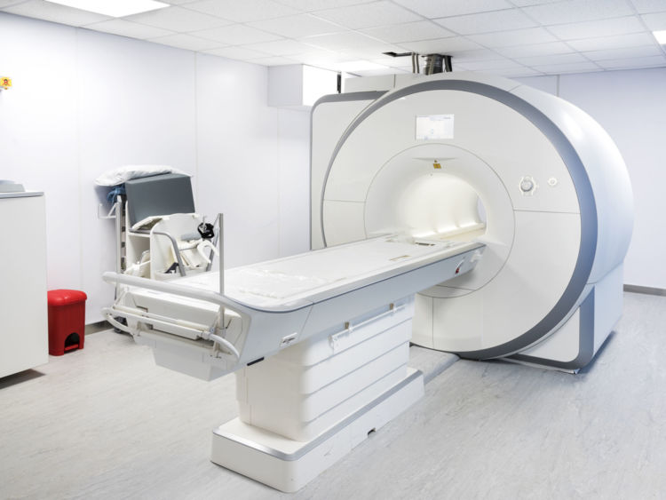
Image Processing Setup:
The flow describes the outline of ImageProcessing that how Dicom Images are sent to Server and Retrieving Dicom Images from Server etc.,
CT
Server
CR
Ultrasound
computer
laptop
tablet
Smart phone
MRI

Slide 4
Image Processing Screen flow

Slide 5
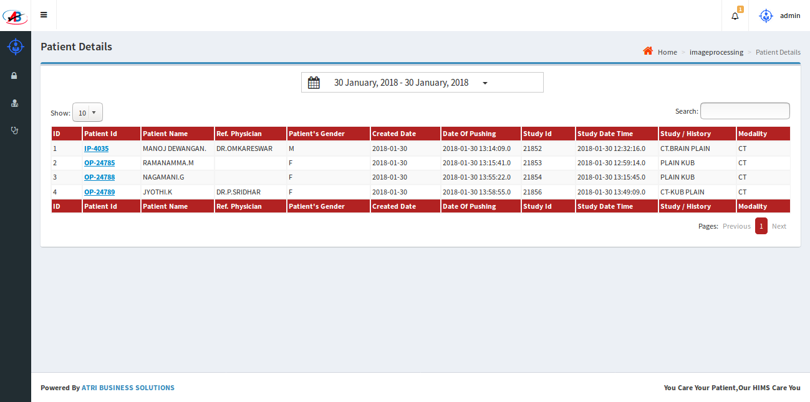
Doctor’s Panel
Doctor can view all the Patient Details after login for the current date and can also view details of the patient for selected past period.

Slide 6
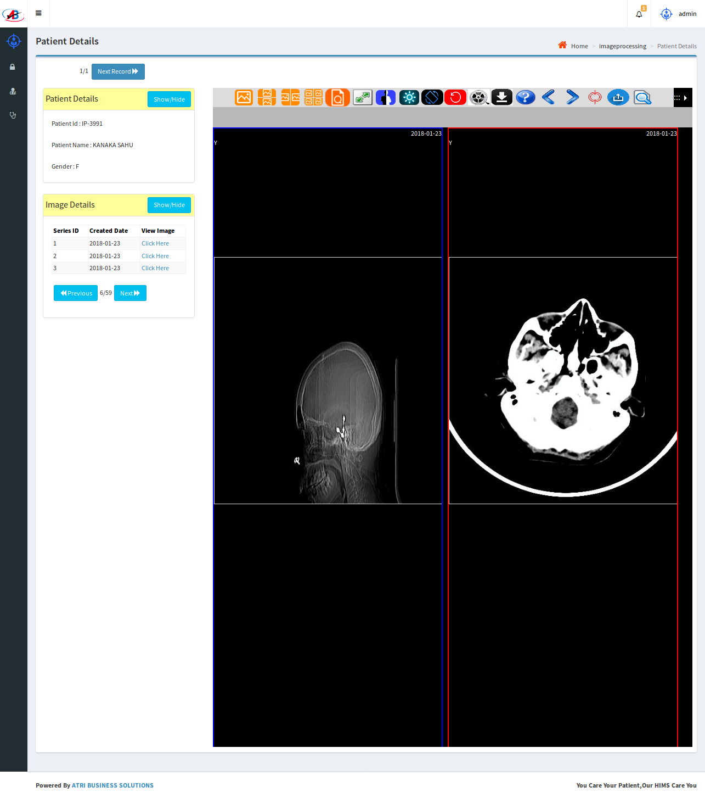
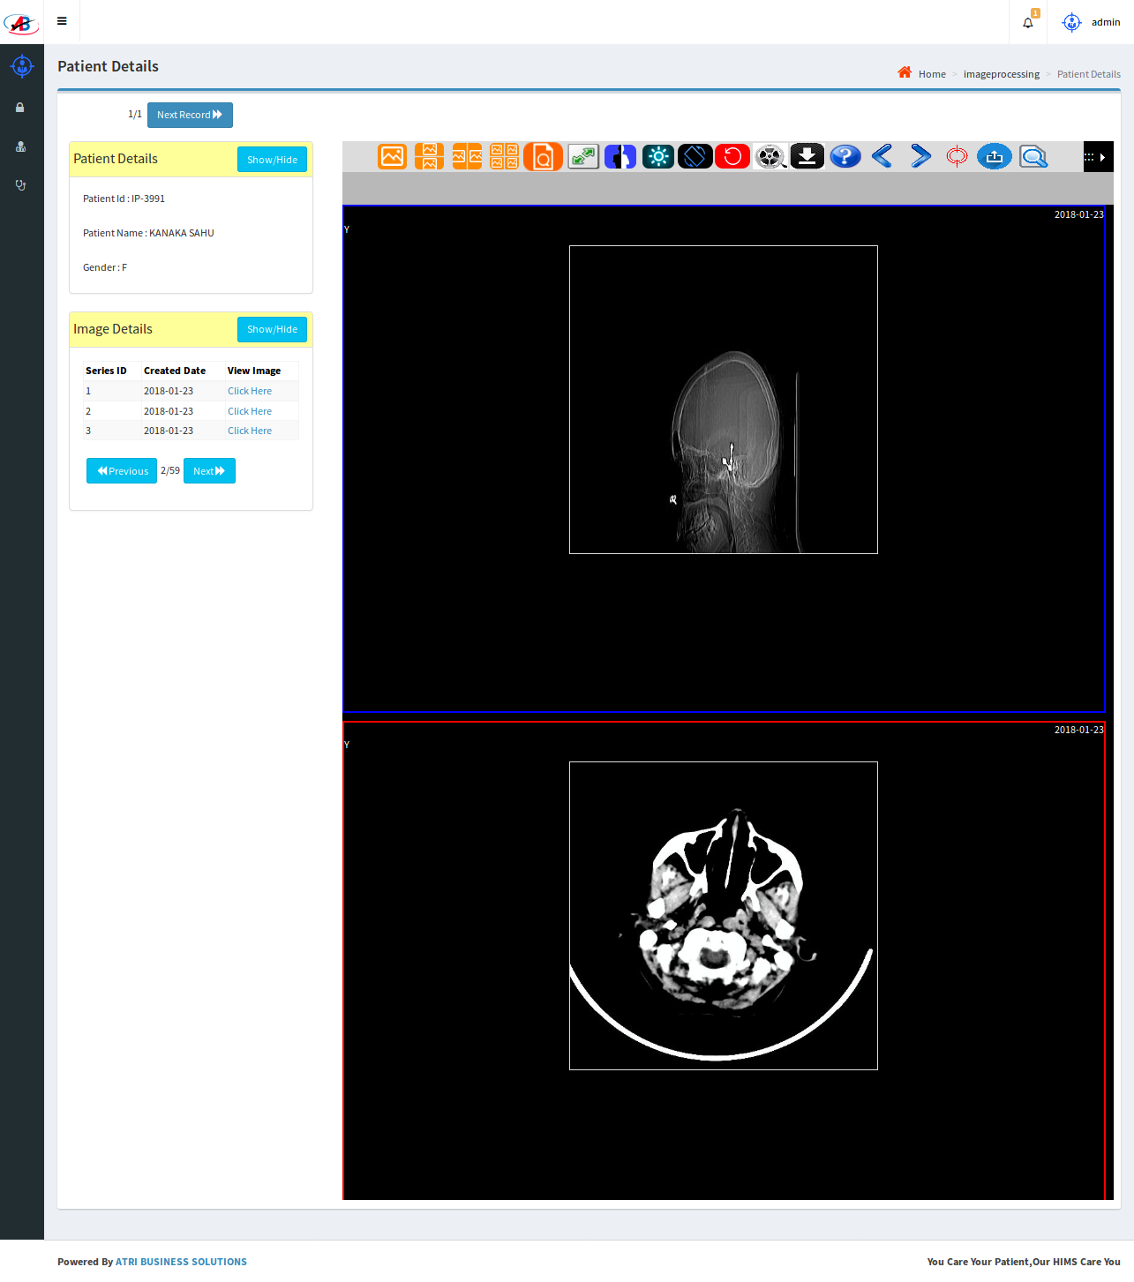
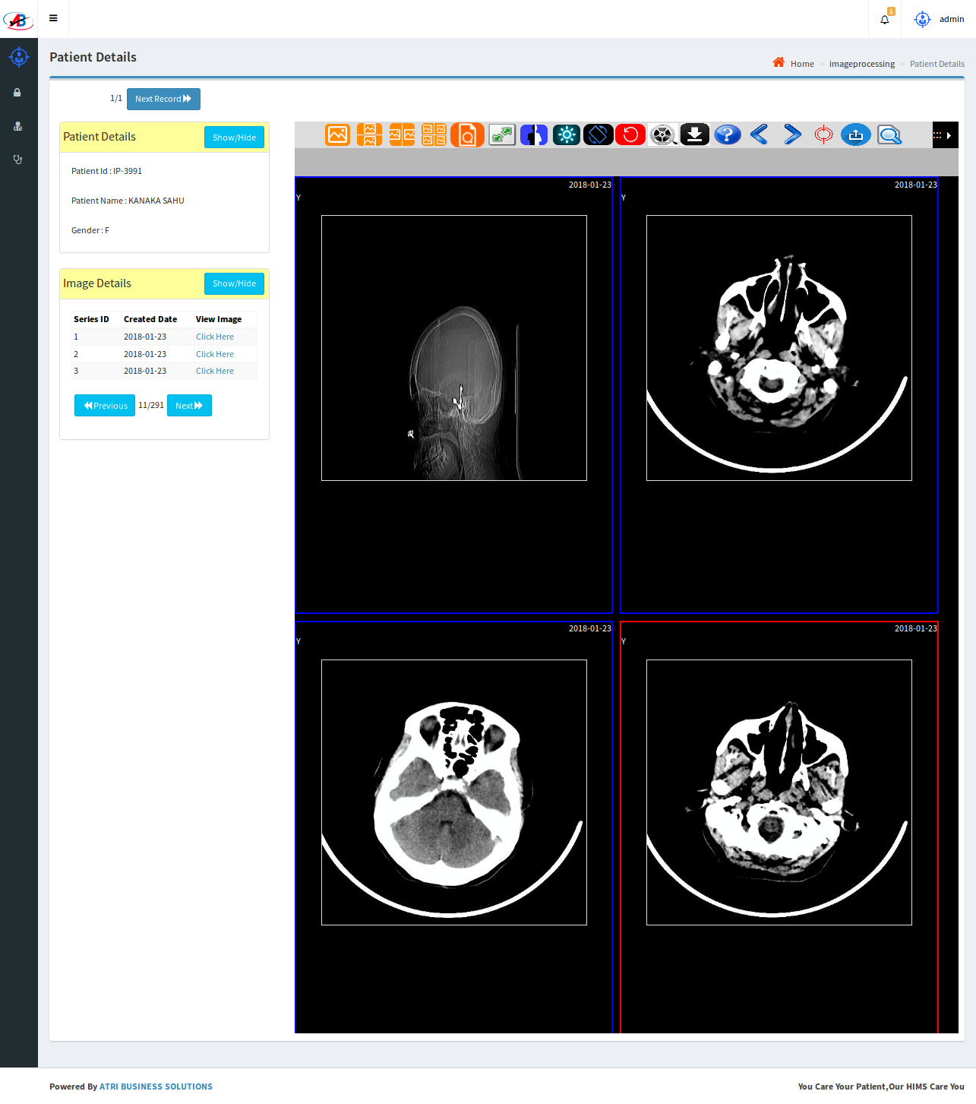
Doctor’s Panel
Doctor can view more than one image on one screen using Horizontal, Vertical or 4 Screens option
Doctor can Zoom-In, Zoom-Out, Invert the Images
Doctor can Rotate, Adjust Brightness and can Edit the Images.
Doctor can save copies of the edited images with any notes written on the images for future refence
Vertical screen Horizontal screen 4 screens

Slide 7
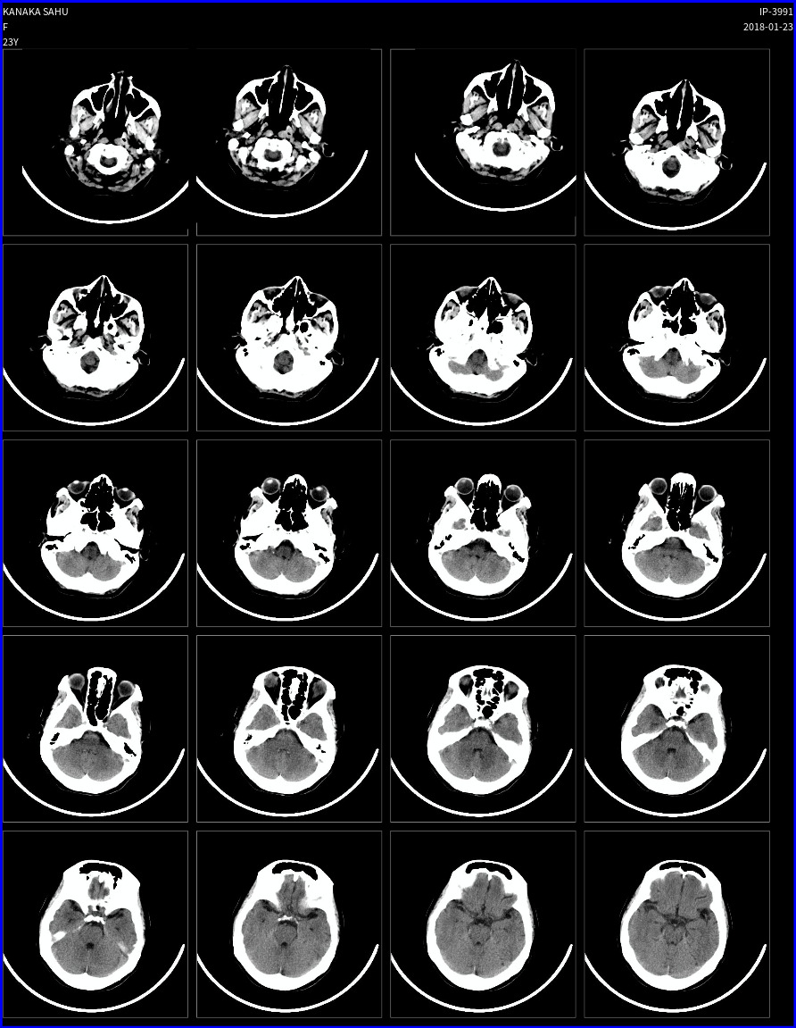
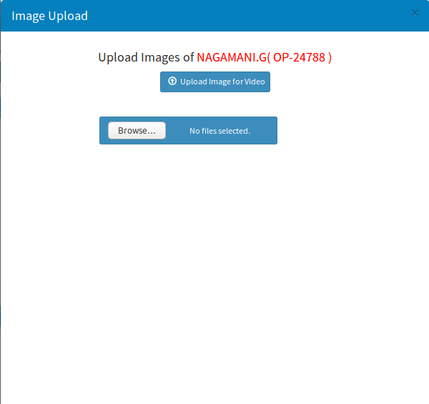
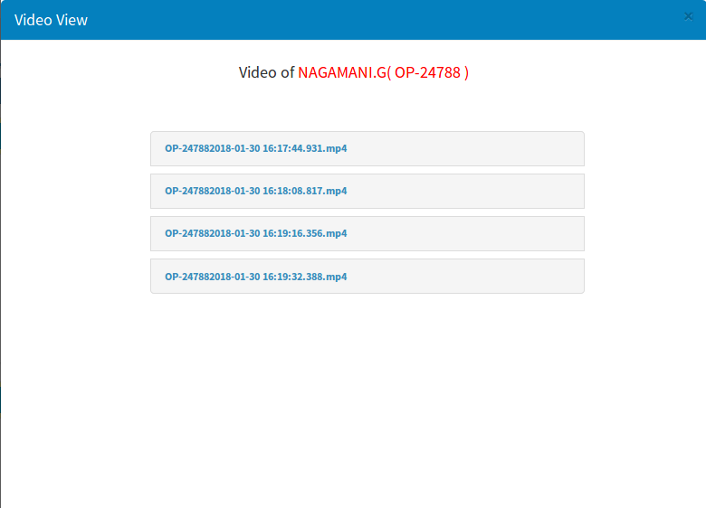
NTR Aarogya Seva Panel
Aarogya Seva user can see multiple Images on one Screen and can Edit Images and can upload the same into Aarogya Seva website
The user can see the uploaded multiple images in the format of a video.
Upload images Upload multiple images view videos

Slide 8
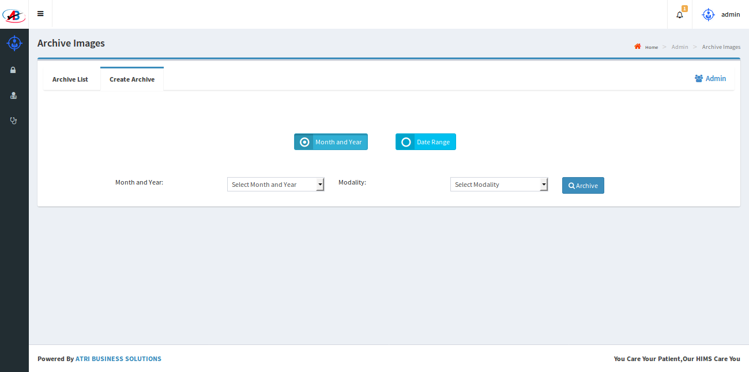
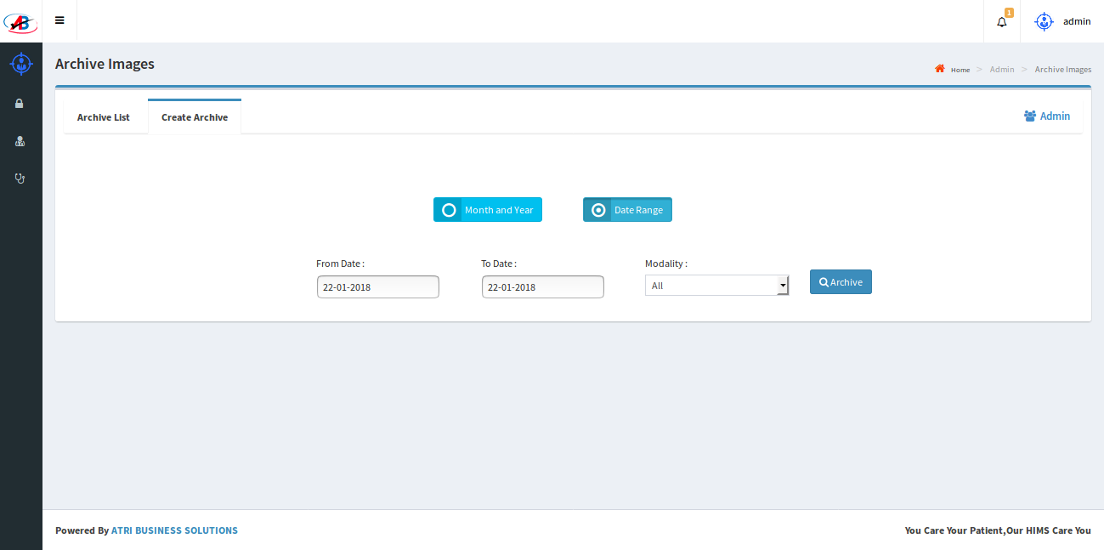
Admin Panel
Archival: Older images can be archived for selected period to free up space on the main server
The archived images can be retrieved using Retrieval option that is provided in the application and this feature is useful to retrieve older images for any necessary reference.
Month and Year Between two Dates

