Slide 1
Human Resource Management (HR)

Slide 2
HR Application
We have Web based HR application which can track effective hours worked by each employee by tracking in/out times through biometric system
Our HR application maintains complete profile of each employee
We have integrated Leave Management to maintain complete employee leave details based on the organization’s leave structures.
Our module integrates with bank management to maintain employee bank details and this information is used for depositing employee salaries.
We are also using Roster sheet to assign work for employee through out the month and we can also replace employee if any employee is absent on specific day.
This module covers Payroll Management based on the employee attendance with complete salary structures.
We have appraisal system integrated with our HR application
Our HR application covers wide range of reports at individual/department/organization level
Various modules covered in this application are:
Recruitment & selection
Training and development
Performance appraisal and feedback
Pay and benefits.

Slide 3
Diagram
Human Resource Management
Initial Setup
Leave
Management
Pay Roll
Management
Reports
1.Company Setup
2.Location Setup
3.Department Setup
4.Designation Setup
5.Currency Setup
1.Leave Structures
2.Leave Application
3.Leave Approval
4.Public Holidays
5.Update Emp Status
1.Salary Rules
2.Employee Appraisal
3.Appraisal Increment
4.Employee Loans
5.Employee Bonus
1.Current Day Report
2.Employee Report
3.Muster Roll
4.Paysheet Report
5.Data Migration
6.Joining Date Report
1.Initially the company, departments and designations have to be created.
2.The flow starts from employee registration along with bio-metric access and unique employee code is generated.
3. All the transactions related to that employee are tracked through the employee code.
->Some more screens in this application are:
1. Employee Registration
2. Employee Roster
3. Employee Permissions
4. Bank Management

Slide 4
Human Resource Screen Flow

Slide 5
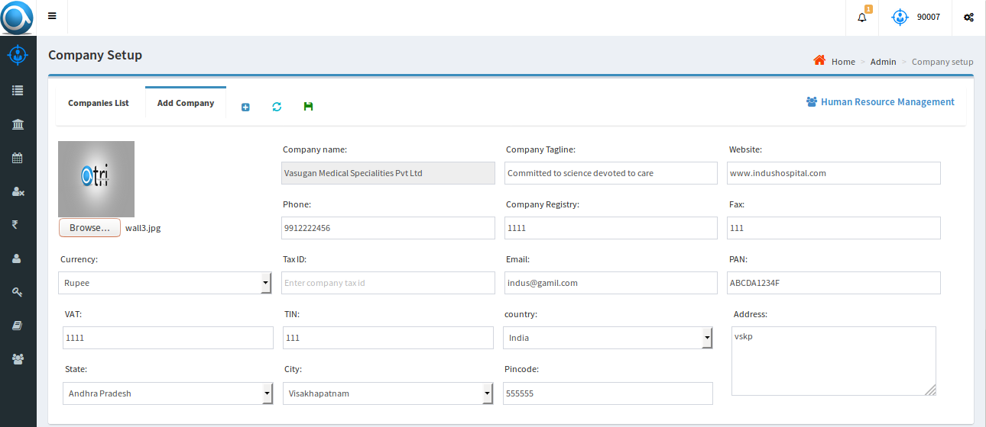
Initial Setup Screens
Company Set up: By using this page we can create a company with complete details and we can update existing company details if there are any changes.
Other items that can be set up: Location, Department, Designation,

Slide 6
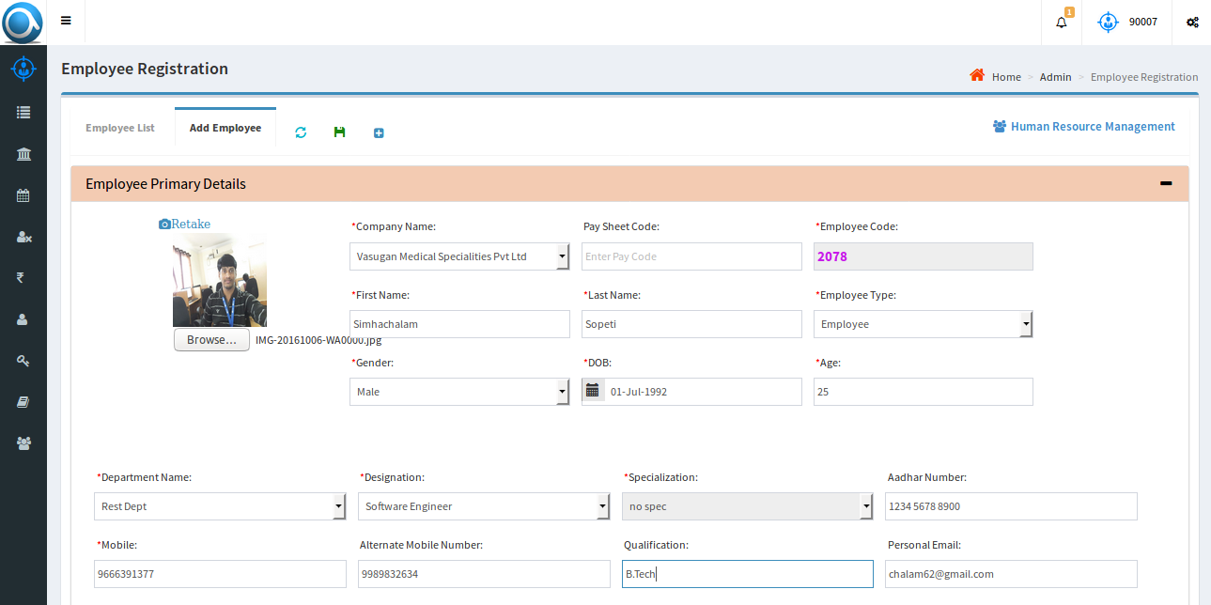
Employee Registration
Add new employee: By using this screen we can register new employee along with his picture
The complete list of employees can be viewed

Slide 7
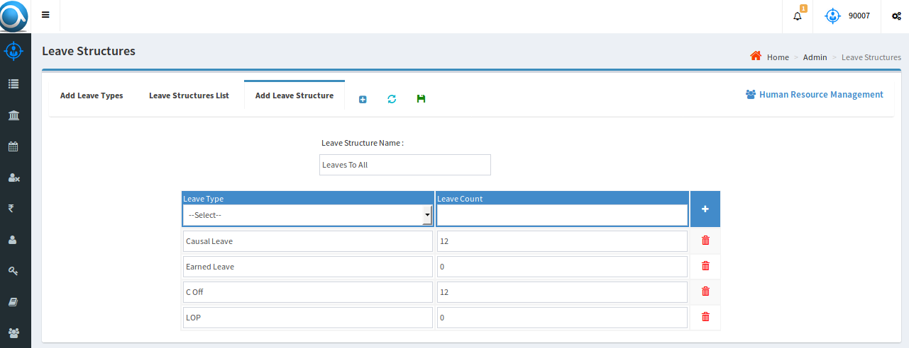
Leave Management
Leave Structures: Leave types and structures applicable to the organization can be created.
Relevant leave structures is applied to the employee at the time of registration.

Slide 8
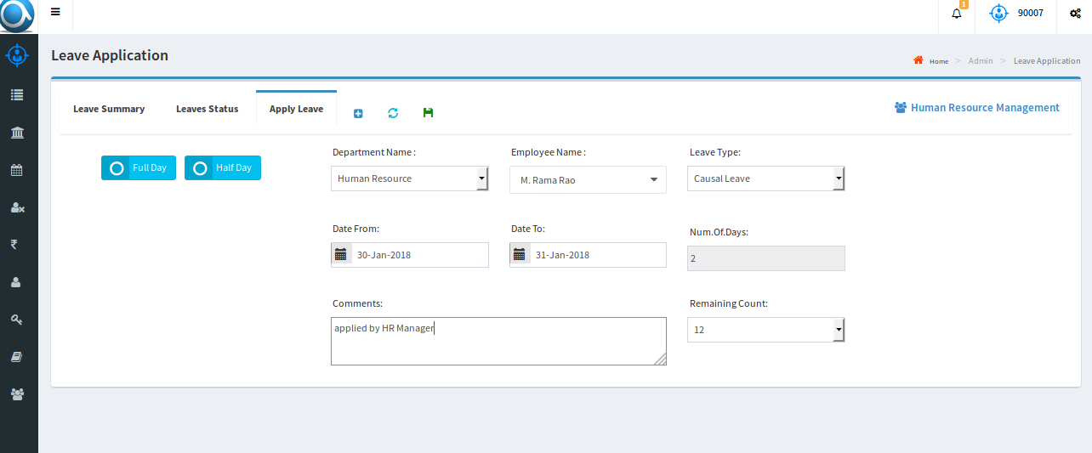
Leave Management
Leave Application: By using this screen employees can apply leaves based on availability and eligibility.
Public holidays can be set up
Employee permissions can be handled

Slide 9
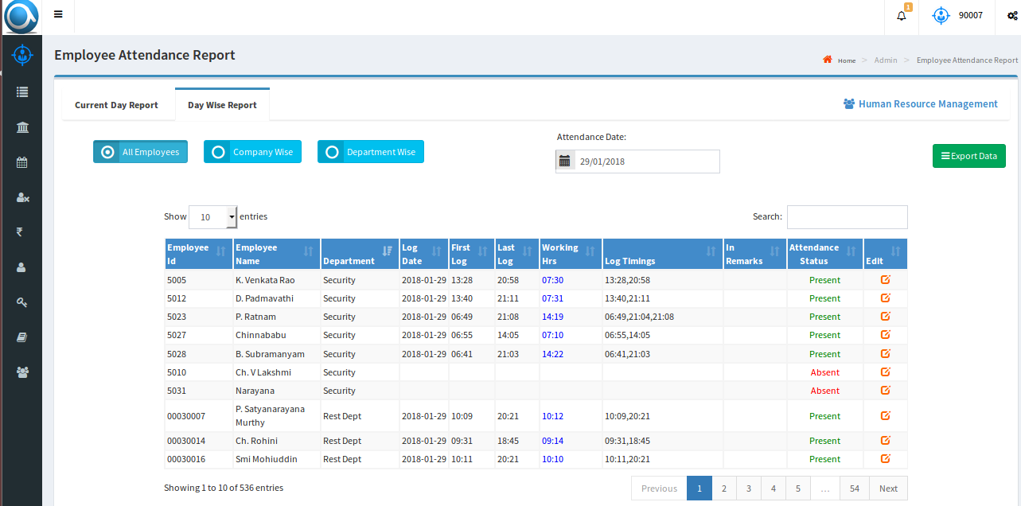
Employee Reports
Day Wise report: This report covers details of employees present & absents.
Other Reports: Monthly report, Muster Roll report, Pay Sheet report

