Slide 1
House Keeping (HKS)

Slide 2
House Keeping System
One of the biggest challenges in hospitals is proper hygiene and cleanliness and manual tracking of the same leaves many loopholes in meeting the targeted standards.
Our HKS application automates the process right from roaster creation under various shifts, house keeping, inspection and verification with proper proof in terms of pictures/videos managed through the application.
Our HKS application has provision for generating various kinds of reports encompassing repeated house keeping activity due to failure to pass through inspection process, performance of each HKS staff.
The stored records can be vital during quality audits like NABH.

Slide 3
House Keeping Screen Flow

Slide 4
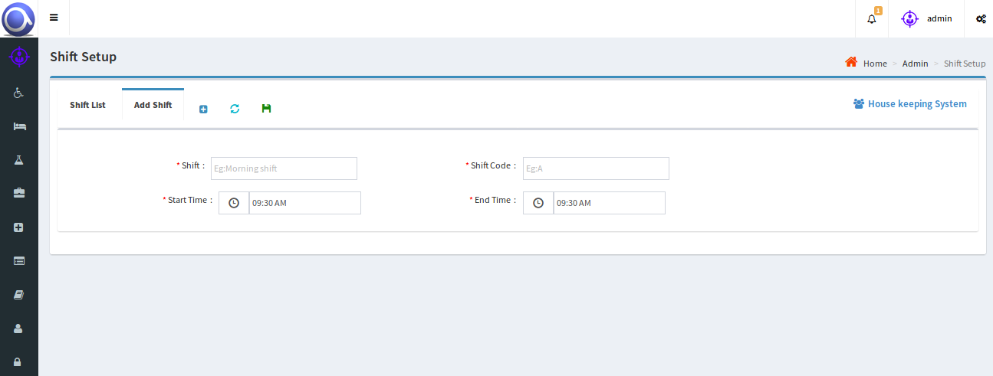
Shift Setup
Initial Setup:
All the valid shifts can be initially entered in shift setup page and the same can be edited or deleted, if needed.
ADD SHIFTS

Slide 5
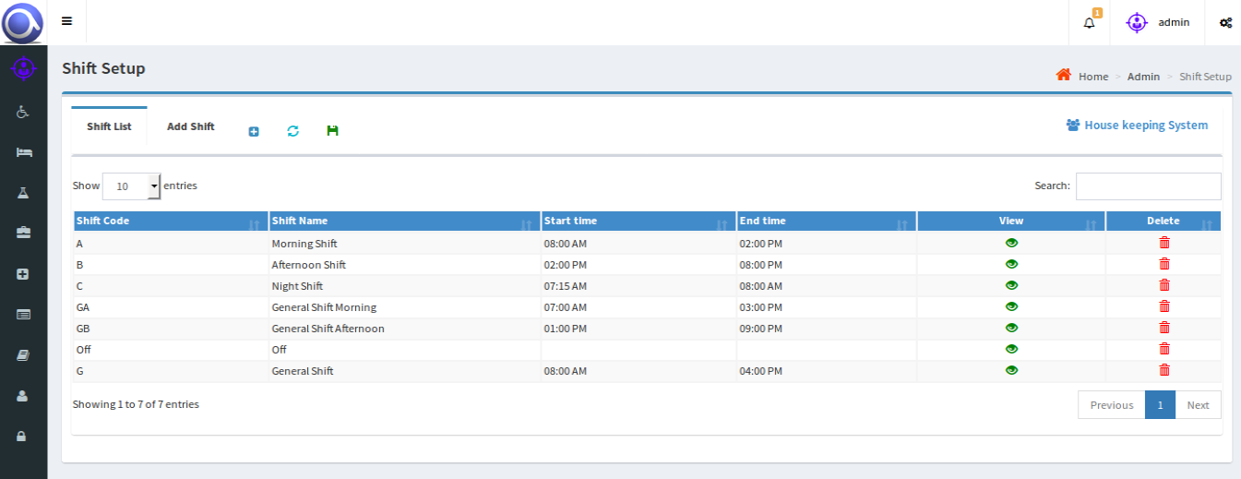
Shift Setup
All the entered shifts can be seen and modified if needed.

Slide 6
Other Tasks that can be Setup
Task Setup : All the HKS tasks can be initially entered in task setup page and the same can also be edited or deleted, if needed.
Activity Setup: All valid activities can be set up using Activity Setup screen. Some valid activities are ‘Daily Activity’, ‘Weekly Activity’, ‘Monthly Activity’.
Service Setup: All the activities which were entered earlier are mapped to every area with shifts i.e., the work that has to be done in every particular area.
Roster setup: Here in this page, roster for all the HKS employees is prepared for a month. The activities which are mapped to that particular area are assigned to the employees.

Slide 7
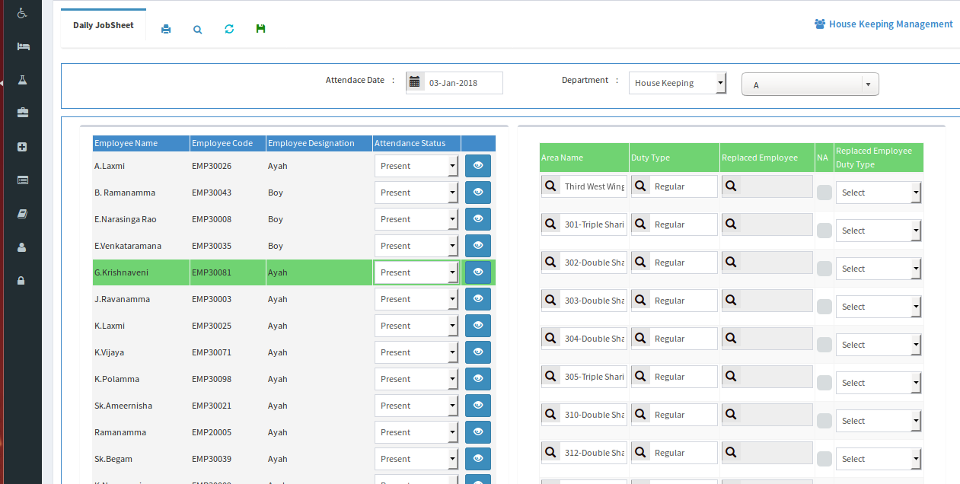
DailyJobsheet : Once the roster has been created for all the hks employees for a month, the hks user can be able to view the roster details of every employee date wise and can give attendance to the employees.In this page we can view the employees with their respective assigned areas(that are assigned in roster page).In this page we can replace employee, if any employee is absent and areas can also be changed.
The Dailyjobsheet page is as shown below:-
VIEW DAILYJOBSHET

Slide 8
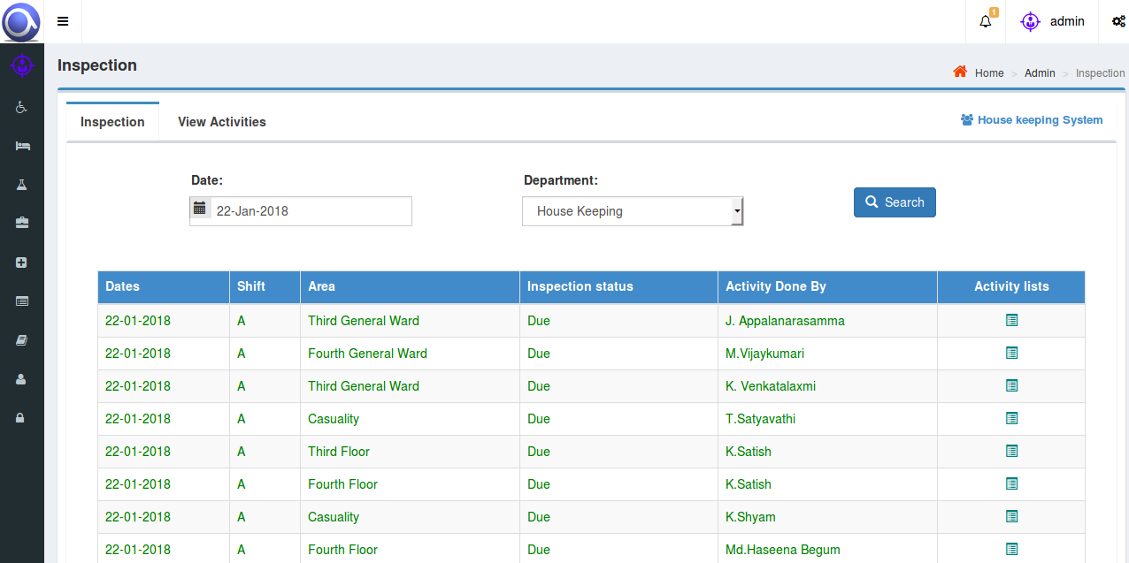
INSPECTION
The work that has been completed can be inspected and images/videos can be uploaded as necessary proof.

Slide 9
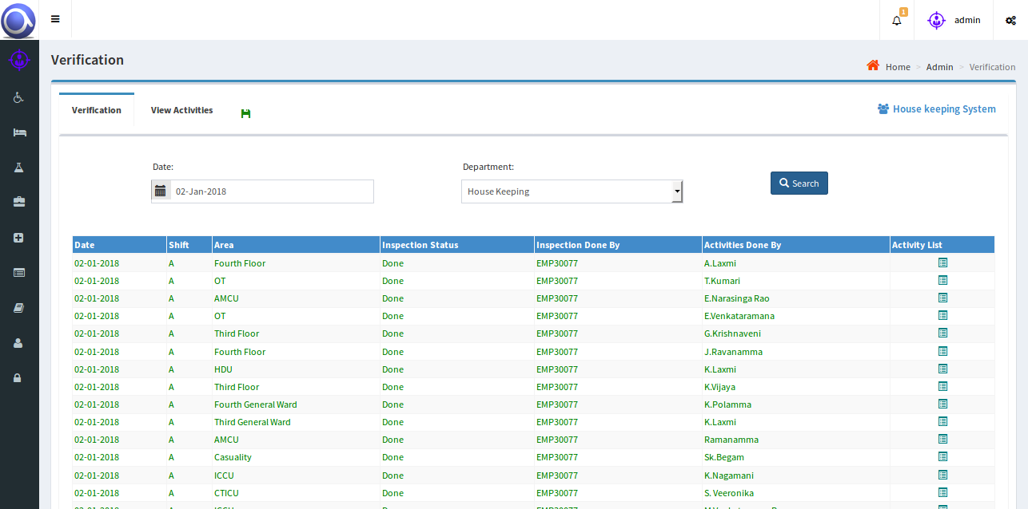
VERIFICATION
The work that has been completed is verified along with uploaded images and videos.
The verification status will be updated after successful verification or will be changed to ‘Redo’, if the work has to be redone.

Slide 10
Reports
Our application covers two types of reports
Staff Allocation-wise Reports.
Job Allocation-wise Reports.
Staff wise reports :-
- Reports like where an individual employee has done his work with date and shift
the employee who has done the inspection and verification. The images and videos that
are uploaded for all the areas can also be viewed.
Shift-wise and Date-wise reports can also be viewed.

Slide 11
Staff allocation-wise reports

Slide 12
Staff allocation-wise reports

Slide 13
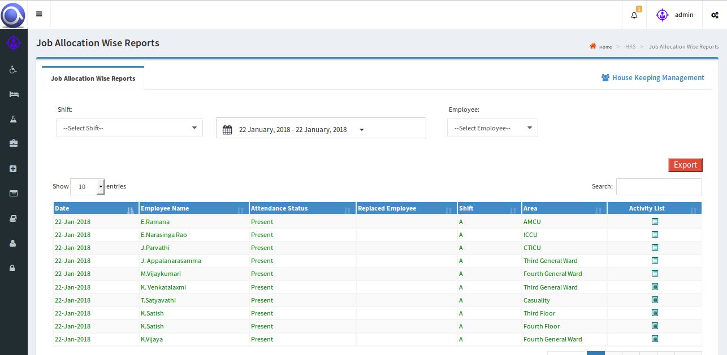
Job allocation-wise reports
Shift-wise, Employee-wise and Date-wise work by each employee can be viewed

